Slide 1
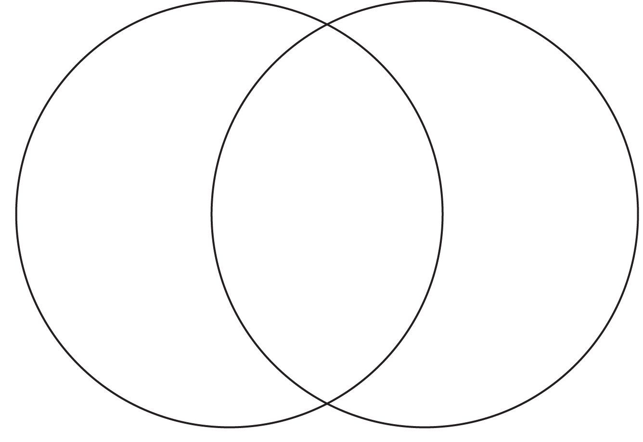

Slide 2
Jane + Rochester?
Draw a Venn diagram
Label one side “Jane” and the other “Rochester” (or if you’re on a first-name basis, you can call him Edward)
Put the following characteristics in their proper place — you MUST use the book to justify your choices:
Looks
Intelligence
Worldly experience
Religiosity
Wit/humor
Wealth
Love
Determination
Pride
Self-sacrifice

