Slide 1
Fold your paper
Left side
Right side
Write the concrete item you see/that is listed
Write at least one non-concrete thing/idea that item could symbolize

Slide 2
Item #1

Slide 3
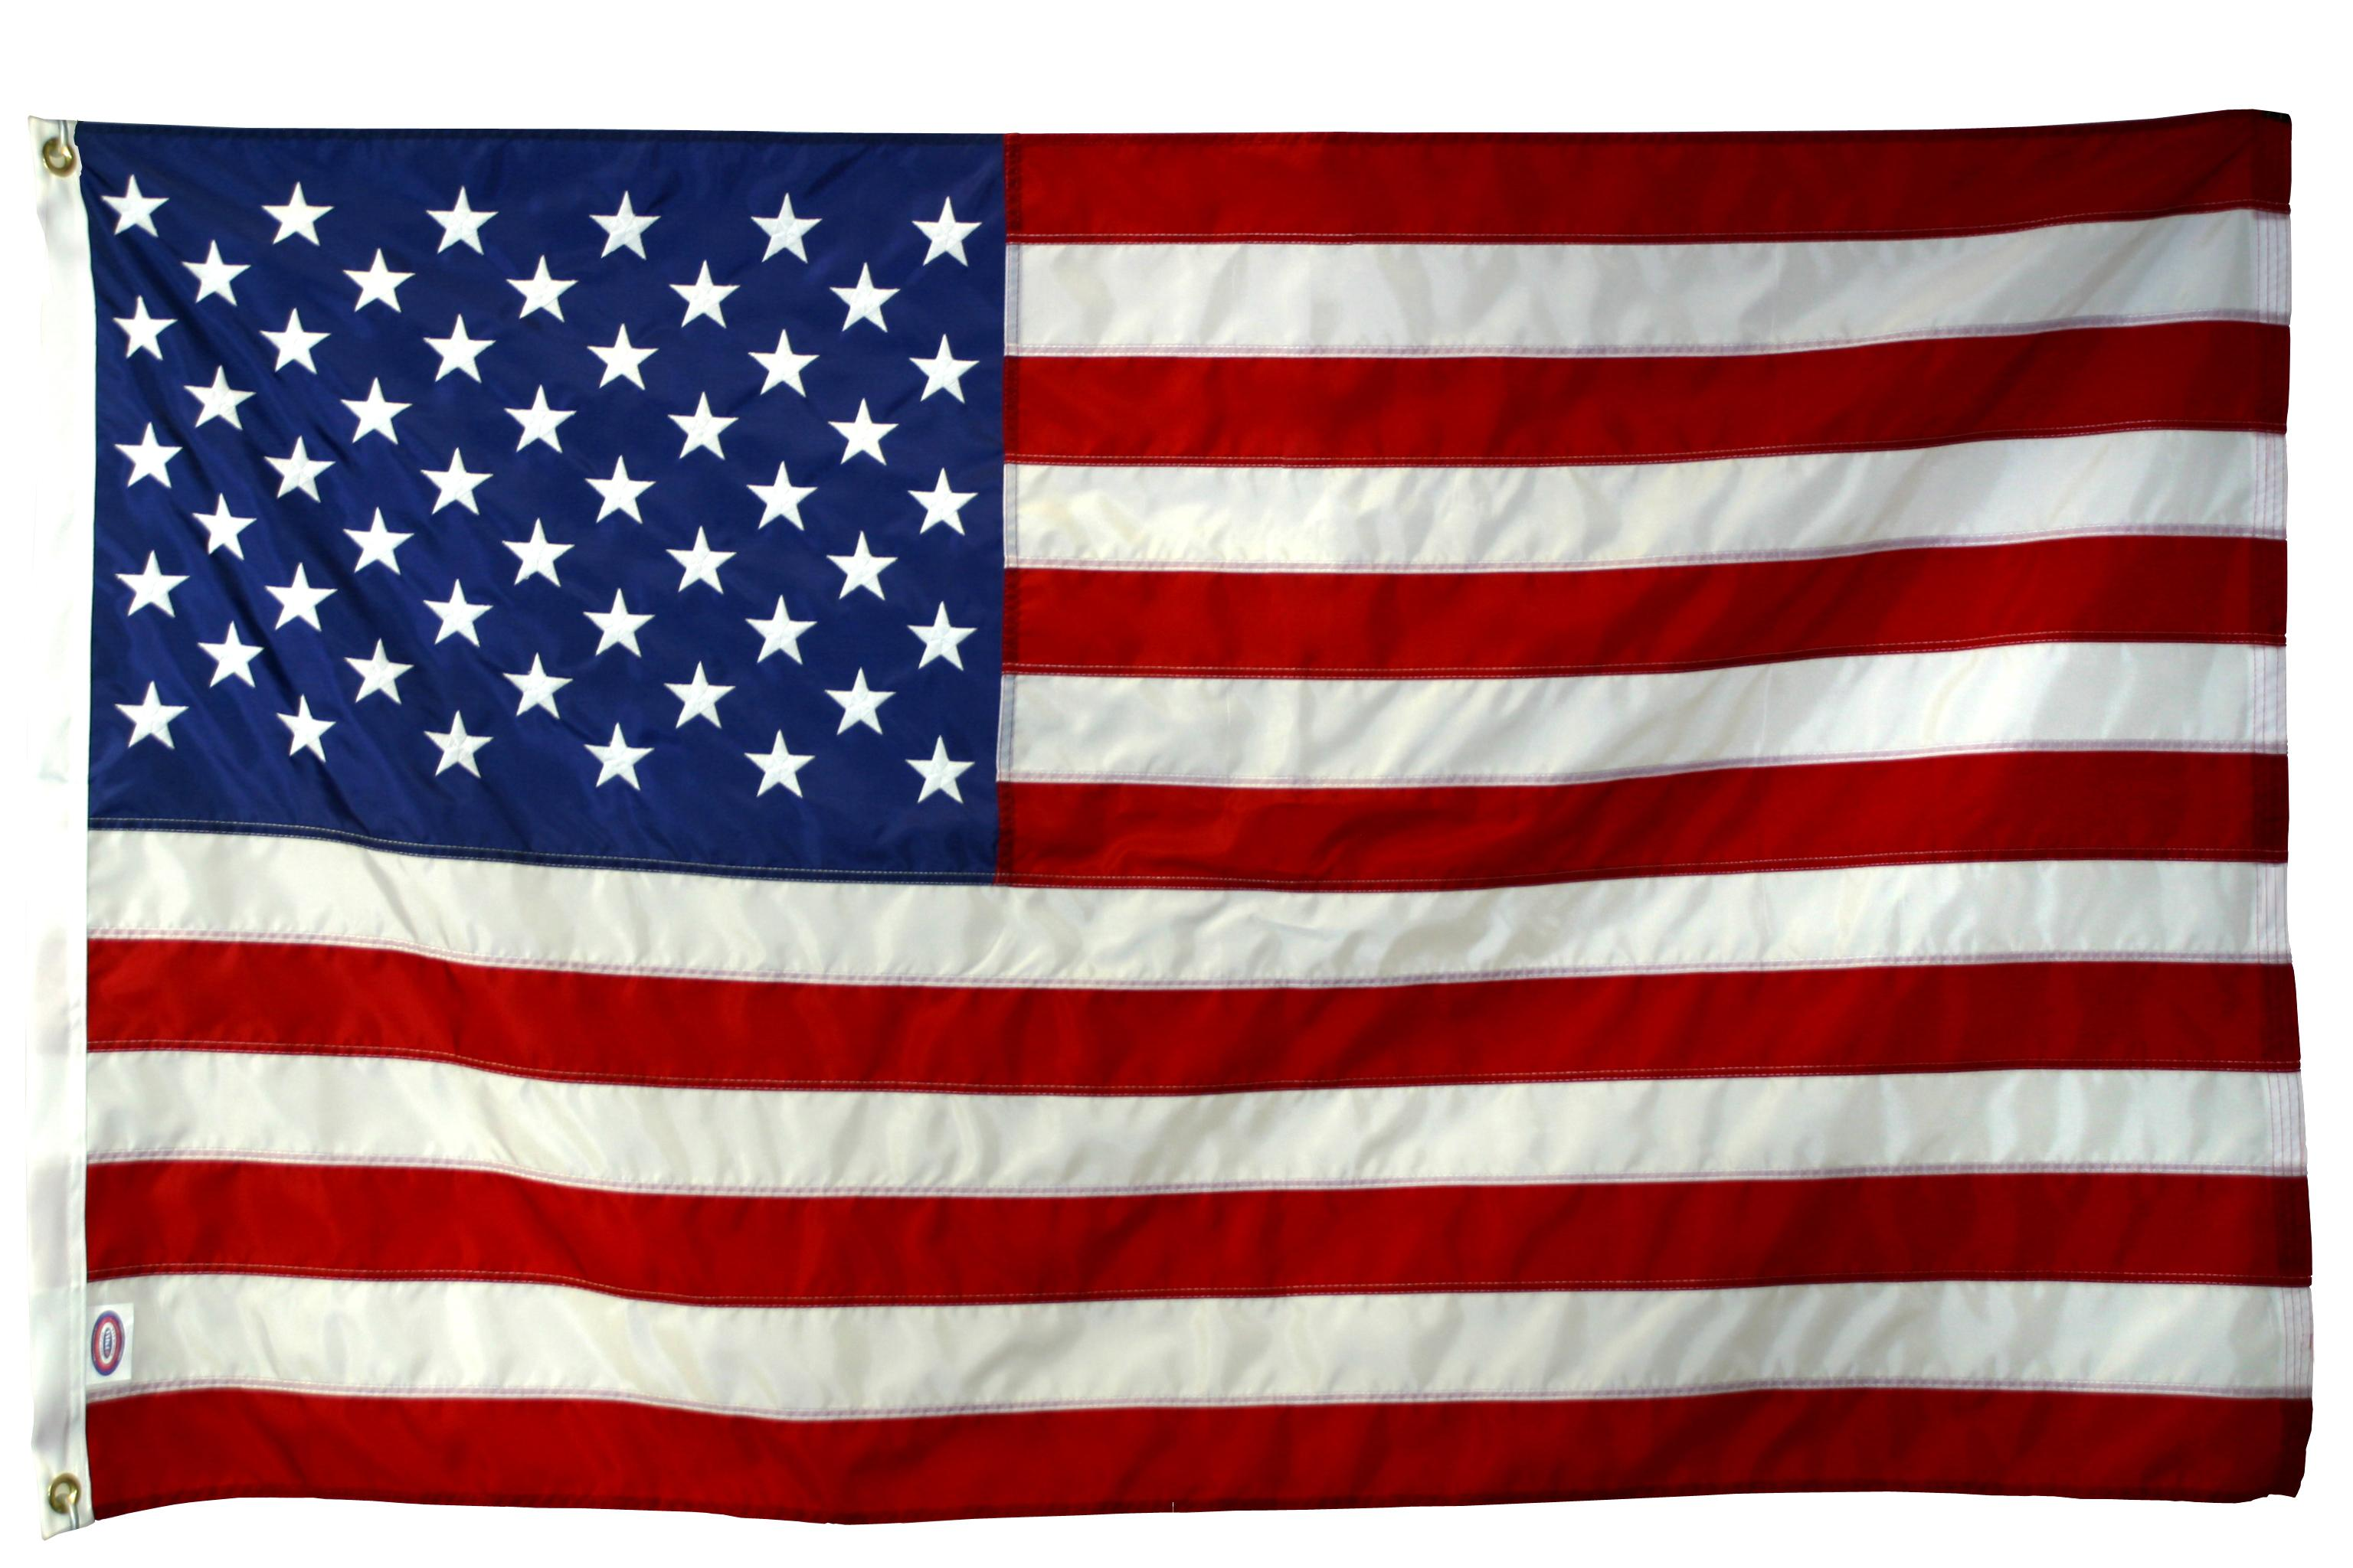
Item #2

Slide 4
Item #3
Red

Slide 5
Item #4
Sunrise

Slide 6
Item #5
An open/closed door

Slide 7
Item #6
Roses
* Does the color matter?

Slide 8
Item #7
Wind & storms

Slide 9
Item #8
Winter

Slide 10
Item #9
An apple

Slide 11
Item #10
A candle

