Slide 1
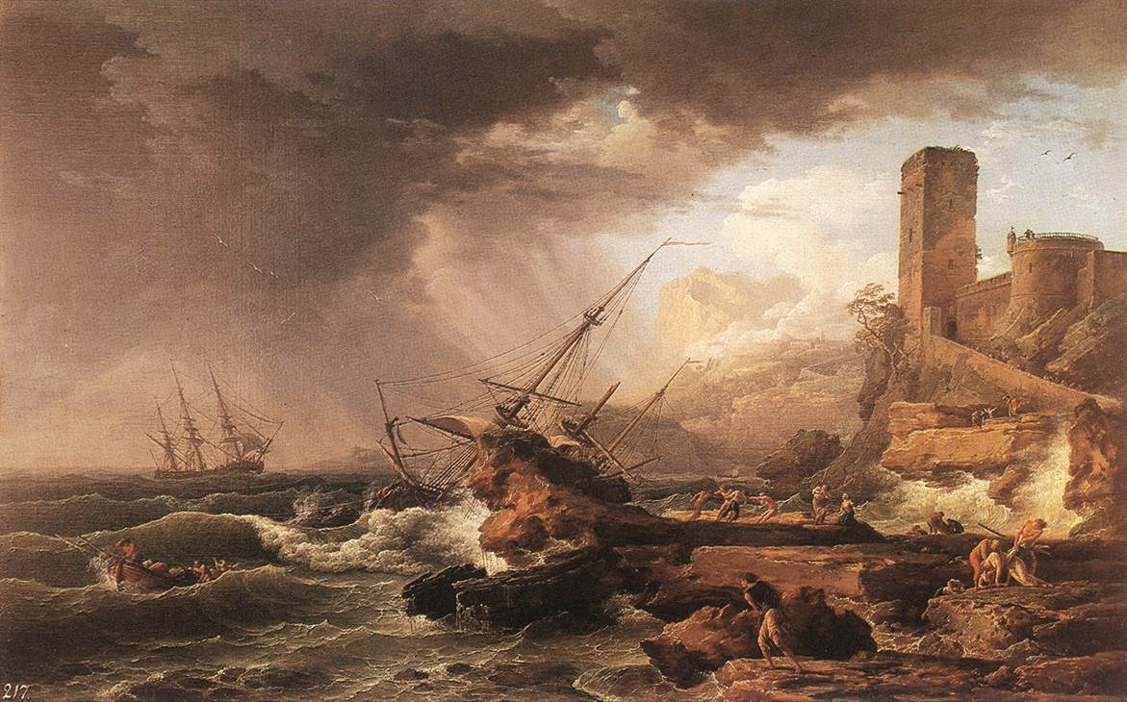
Romanticism

Slide 2
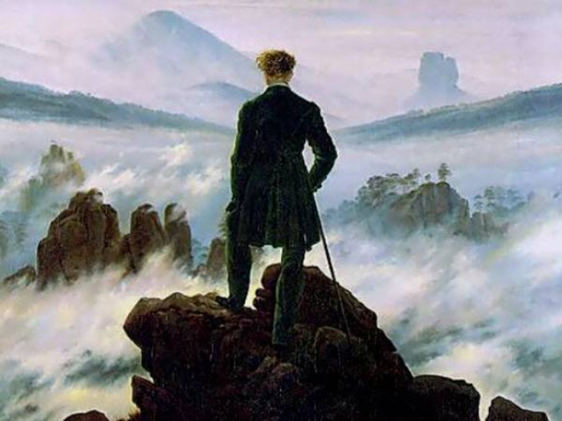
Notes:
Caspar David Friedrich

Slide 3
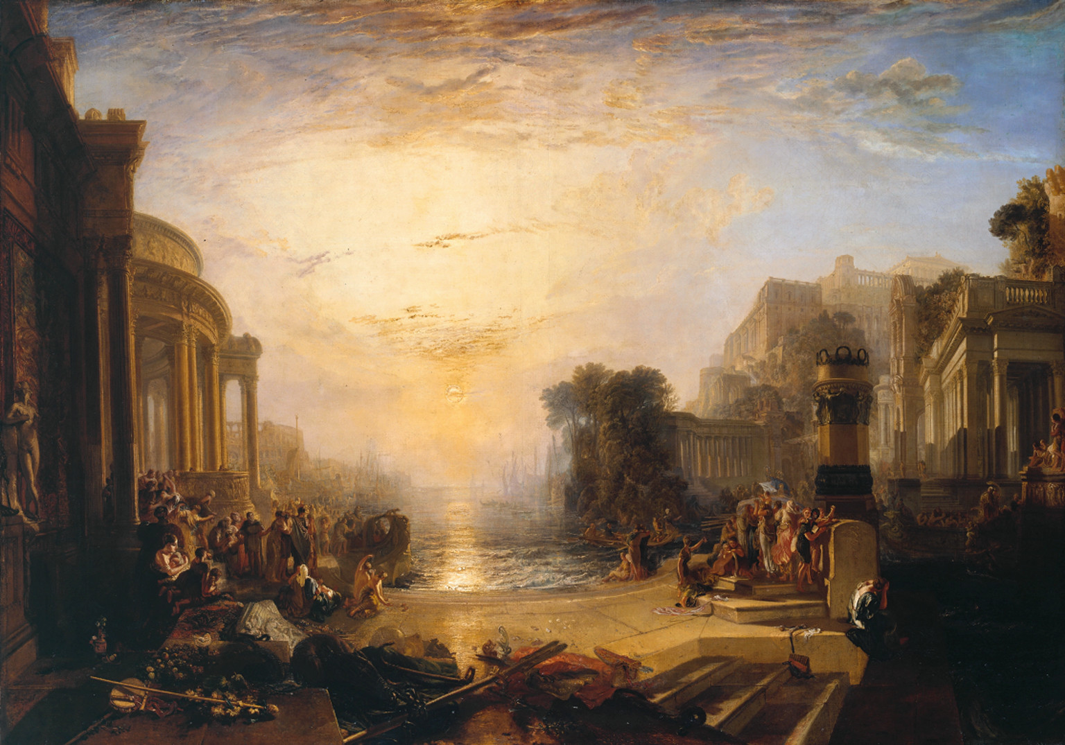
Notes:
J.M.W. Turner

Slide 4
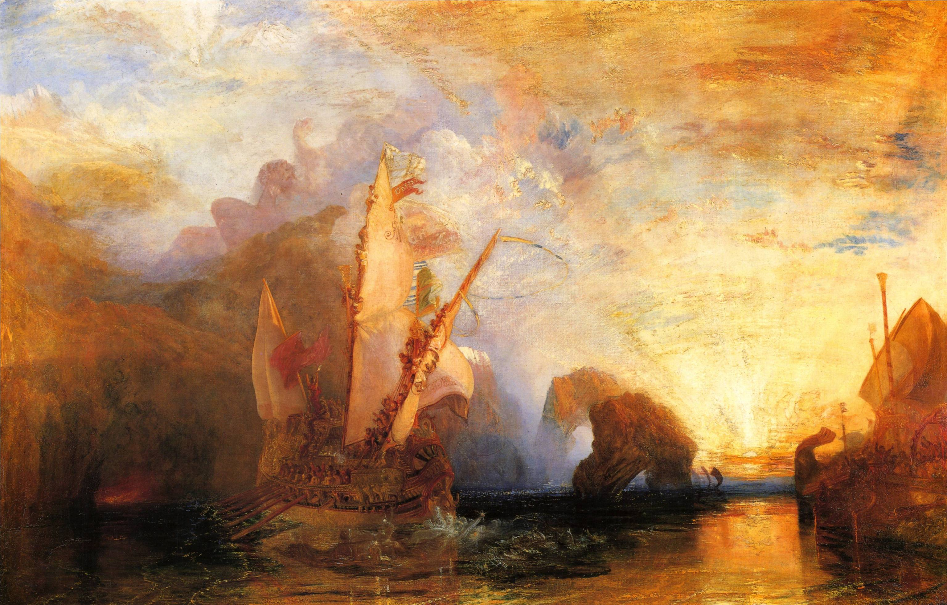
Notes:
J.M.W. Turner

Slide 5
Romanticism was an artistic movement in the 1800s that affected everything from literature to art, architecture, and music
Romanticism rejected order, calm, harmony, balance, and rationality
Romanticism celebrated emotion over reason

Slide 6
Romanticism was obsessed with the tortured hero, the creative spirit, the moody wrongdoer, the passionate lover, and exceptional people
Romanticism was also obsessed with the medieval era, the mysterious, the exotic, the weird, the occult, and even the satanic

Slide 7
How is “The Scarlet Letter” a Romantic book?

