Slide 1
Real-world writing
The Resume

Slide 2
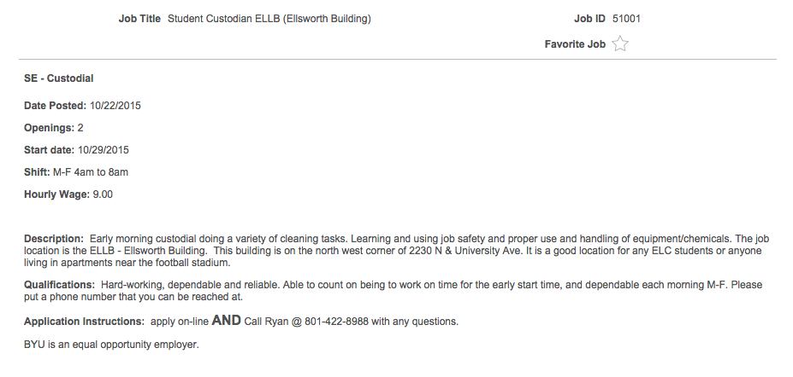

Slide 3
The resume
Job hours: M-F 4 a.m. to 8 a.m.
Hourly wage: $9
Description: Early morning custodial doing a variety of cleaning tasks. Learning and using job safety and proper use and handling of equipment/chemicals.
Qualifications: Hard-working, dependable and reliable. Able to handle early hours.

Slide 4
The resume
Most jobs require a resume, or a one-page summary of your skills, education, and experience
Resumes are all about convincing someone you’re perfect for their job
What is the hiring manager looking for?
Hard-working, dependable, reliable, able to handle early hours

Slide 5
The resume
Potential employers usually spend fewer than 30 seconds looking at each resume
You have 30 seconds to get it right

Slide 6
Step 1: What should it look like?
Necessary elements:
Heading (personal info)
Career objective
Education
Work experience
Activities
Summary of skills
References

Slide 7
Heading
Heading:
Your formal name (make it stand out)
Your address
Your phone number
Your email address

Slide 8
Objective
Objective:
Generally a one-sentence explanation of the type of job you are seeking
Should be specific — don’t have one generic objective listed

Slide 9
Education
Education:
As a college student, don’t mention high school
As a high school student, DO mention high school
Where you are attending; dates of attendance, graduation, or expected graduation; major and degree; academic honors; classes relevant to the job

Slide 10
Experience
Experience:
List previous employers, their locations, your dates of employment, and your job title
Include short descriptions of what your job duties and responsibilities were
Do not use “I” in descriptions

Slide 11
Activities
Activities
Employers don’t want slackers — impress them with your involvement at school and in the community
Special activities and committees (student council, baseball team, drama club, etc.)

Slide 12
Extras
Extra skills
Include special skills or things that make you look more useful to the hiring party
Make sure these skills actually apply to the job you want, though

Slide 13
References
References
You can put “References available upon request” at the bottom of your resume
You can also skip that and bring a separate printed sheet of your references, if you prefer

Slide 14
Major section headers
Objective
Education
Employment
Work history/experience
School activities

Slide 15
Minor section headers
Computer experience
Certifications
Honors/awards
Interests and jobbies
Relevant school classes
Volunteer experience
Etc.

