Slide 1
Resume
Required element No. 1: Header

Slide 2
Resume
Required element No. 2: Education

Slide 3
Resume
Required element No. 3: Work experience

Slide 4
Resume
Required element No. 4: Summary of skills

Slide 5
Resume
Required element No. 5: Activities/Leadership

Slide 6
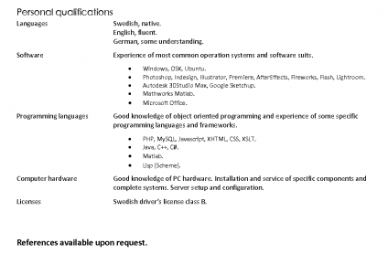
Resume
Required element No. 6: References

