Slide 1
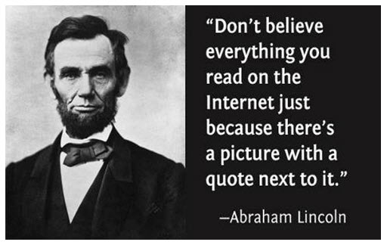

Slide 2
Quote verification
As you researched your chosen person for your Term 2 essay, you surely experienced the joys of quotes found on BrainyQuote, Goodreads, and maybe even Pinterest. The bad news: sometimes (a lot of the time) those types of websites are not vetted, and therefore the quotes are inspiring, but fake. Instructions: Try to verify whether or not the following quotes were ever really said by the person they are attributed to. Use Google, other websites, Google books, IMDB scripts — use whatever it takes, but find out if these quotes are real. Write your answer (true quote or false quote) on a piece of paper, explain how you found the answer, and turn in as many as you can by the end of class.

Slide 3
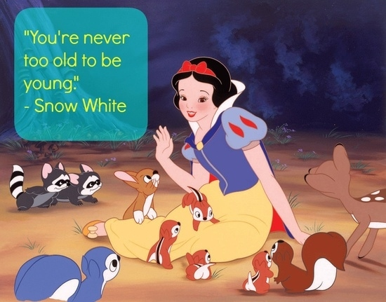

Slide 5
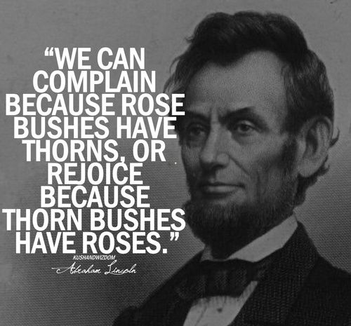

Slide 6
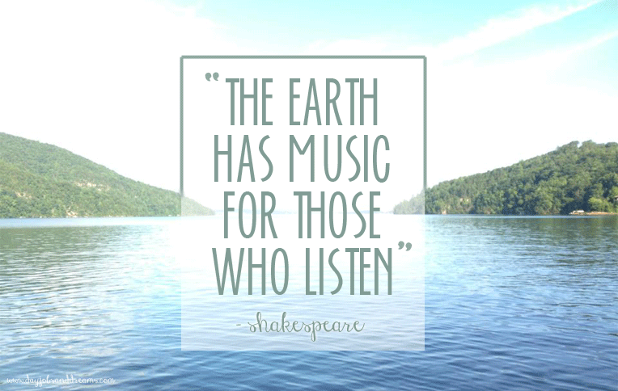

Slide 7
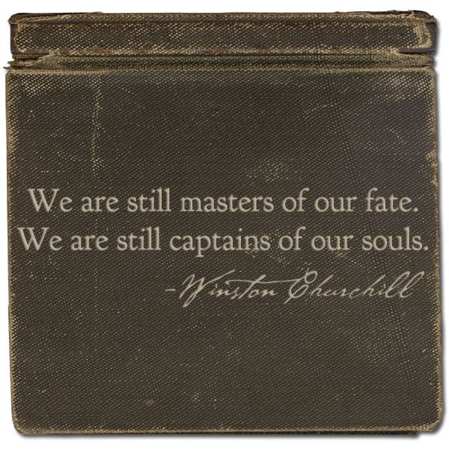

Slide 8
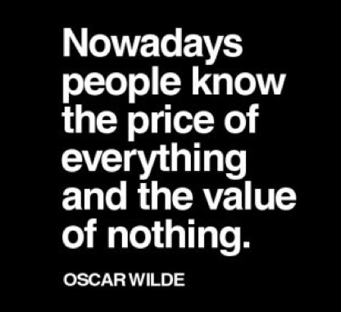

Slide 9
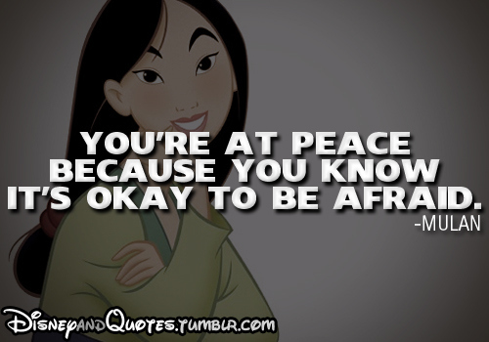

Slide 11
