Slide 1
ePublishing
Your words, from paper to print

Slide 2
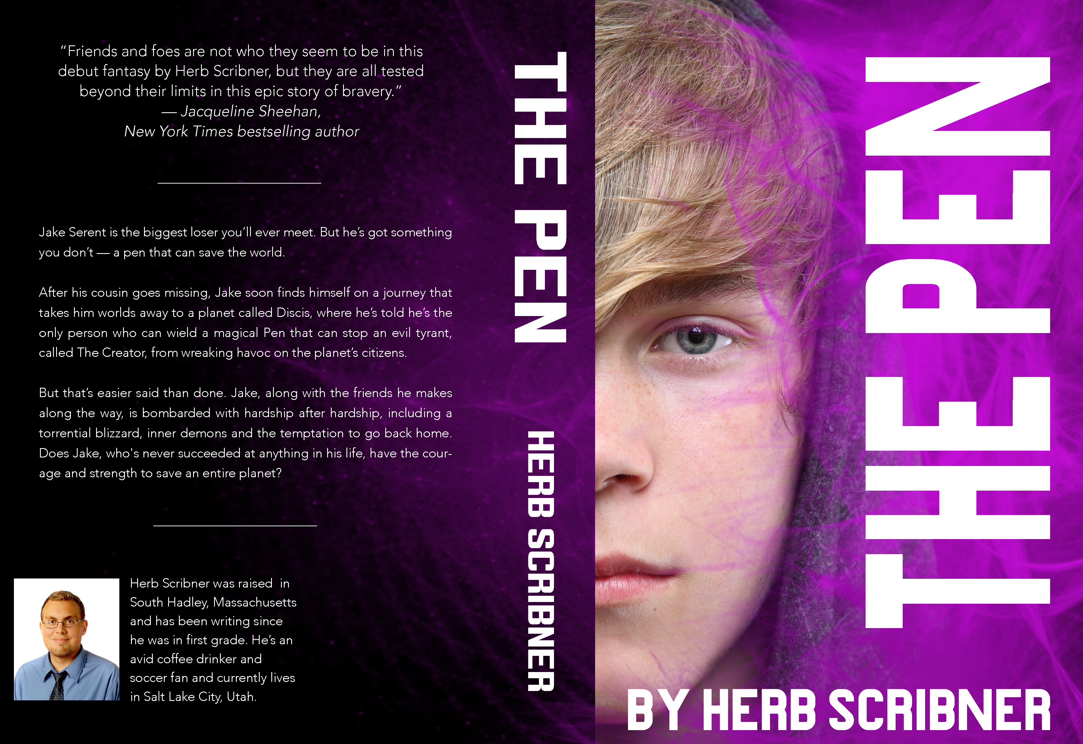

Slide 3
Basic guidelines
You’ll probably have to nix the page numbers and running heads
You can choose your font and font size, but make sure the book is uniform and readable
You don’t have to keep the double spacing on the essays — it’s really better if you don’t
EDIT! Check for spelling, tense, parallelism, spacing, tabs, formatting, dialogue, and other errors

Slide 4
History essay
Keeping the title page is your choice
Figure out how to do footnotes as best you can — it’s easier with Microsoft Word ☹
You will have to make adjustments to the template, and that’s okay!

Slide 5
Crucible & Jane Eyre essays
Keep your Works Cited pages, but nix the name/date/class info on your first pages
You can put the Works Cited info on its own page or include it on the same page as the end of the essay

Slide 6
Much Ado pitch
Make sure you have the required elements! Your pitch should be three pages long — if it’s not, you’re missing something…

Slide 7
Resume & cover letter
You’ll have to adjust your resume and cover letter so they fit in a book format
You CAN go longer than 1 page on both assignments due to the book formatting process

Slide 8
Short story
Dialogue requires a new paragraph whenever the speaker changes and/or the same speaker changes subjects — check that!
Don’t forget your speaker tags
“That is a speaker tag,” he said.
She instructed, “Put the speaker tags at the start or end.”
“Speaker tags,” she said, “can also go in the middle.”
“I know,” she sighed. “Speaker tags can be confusing.”

Slide 9
Graphic novel
Format the longform story like you formatted your short story
Graphic novel, pictures:
You’ll have to decide what works best for your story — you will get a scan of your graphic novel, but how you format it is up to you. Want one square per page? That’s fine. Want the entire thing on one page? As long as it’s readable, that’s fine.

Slide 10
Final narrative essay
Don’t worry about this yet — make sure the ENTIRE BOOK is 100% ready to transfer into the pdf format, and then wait…

