Slide 1
Bellringer:
Grab a piece of paper and answer the following questions:
Write 1 complete sentence telling me 3 things you did over the Christmas break
Write 1 complete sentence telling me 3 things you like to do when you’re not in school (holiday break or not)
Write 1 complete sentence telling me 3 things you wish you had done over the Christmas break
Write 1 complete sentence telling me 3 things that you like about being back in school
Write 1 complete sentence telling me 3 things you plan to do before the end of the school year, in school or life

Slide 2
Parallelism
Like math, but English

Slide 3
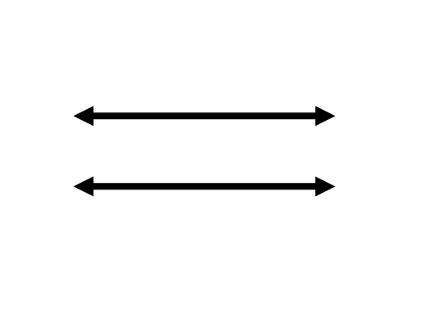
What does it mean to be “parallel”?
In math, parallel lines are two lines on a plane that never meet and are always the same distance apart

Slide 4
What does it mean to be “parallel”?
In English:
Parallel structure - Identical grammatical structures that create a rhythm and balance to connect a flow of ideas
The same pattern of words is used to show that two or more ideas have the same level of importance

Slide 5
Parallelism

Slide 6
Parallelism
In his 1940 speech, Winston Churchill said:
“I have nothing to offer but blood, toil, tears, and sweat”
Churchill did NOT say:
“I have nothing to offer but bleeding, toil, tears, and sweating”
Churchill understood parallel structure

Slide 7
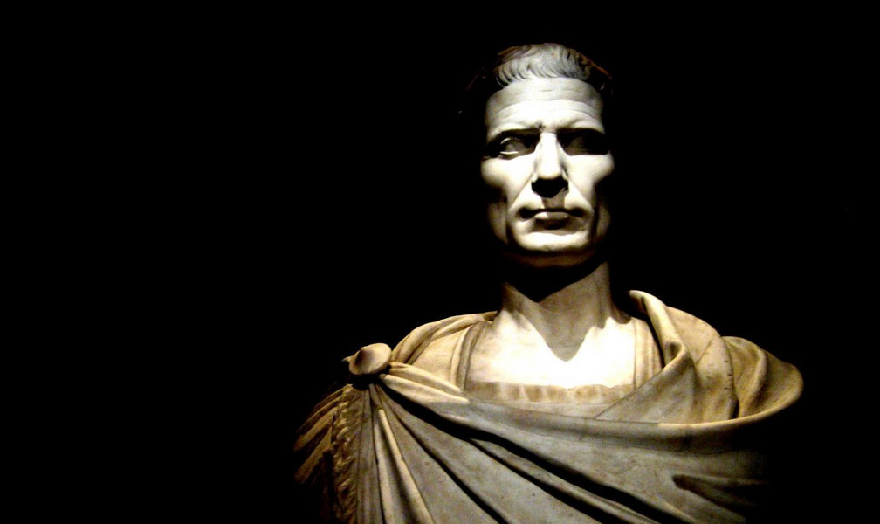
Parallelism

Slide 8
Parallelism
“Veni, vidi, vici”
“I came, I saw, I conquered” – Julius Caesar
Julius Caesar did NOT say:
“I came, I saw, I went conquering”
Julius Caesar understood parallel structure

Slide 9
Basic rule for parallelism:
Do not mix forms
Mary likes hiking, swimming, and to ride a bicycle
Mary likes hiking, swimming, and riding a bicycle
The coach told the players that they should get a lot of sleep, that they should not eat too much, and to do some warm-up exercises before the game
The coach told the players that they should get a lot of sleep, that they should not eat too much, and that they should do some warm-up exercises before the game

Slide 10
Parallelism
Unparallel: Melvin enjoyed rock music, football, and to collect stamps
Parallel: Melvin enjoyed rock music, football, and collecting stamps
Unparallel: Susan pushed the hair from her eyes, wiped the sweat from her forehead, and the volleyball was served
Parallel: Susan pushed the hair from her eyes, wiped the sweat from her forehead, and served the volleyball

Slide 11
Question 1:
As a young woman, she wrote of pining for a valentine and of visiting the Chinese museum in Boston
A. No change
B. visiting to
C. of her visiting to
D. of her visiting at

Slide 12
Question 2:
Others, salt-encrusted, “sleep” in ancient caverns, waking after centuries to feed and to be bred.
A. No change
B. for breeding
C. to breed
D. breeding

Slide 13
Question 3:
We will lie on the beach, swim in the ocean, and we will sleep under the stars.
A. No change
B. sleep under the stars
C. we will be sleeping under the stars
D. we would sleep

Slide 14
Question 4:
The new auditorium is both beautiful and it is spacious.
A. No change
B. it has a lot of space
C. spacious
D. has a lot of space

Slide 15
Question 5:
The grammar exercises are long, difficult, and contain absurdities.
A. No change
B. absurd
C. are containing absurdities
D. are also absurd

Slide 16
Question 6:
One option the students have is to fail the test; the other is working long hours.
A. No change
B. work
C. to work
D. to have worked

Slide 17
Question 7:
You have to be smart, friendly, and show energy.
A. No change
B. have to show energy
C. have to be energetic
D. energetic

Slide 18
Question 8:
Every road to the school is either jammed or is closed for repairs.
A. No change
B. has been closed
C. is being closed
D. closed

Slide 19
Question 9:
More than twice as many people inhabit Nigeria as Ethiopia.
A. No change
B. as in Ethiopia
C. than Ethiopia
D. as inhabit Ethiopia

Slide 20
Question 10:
Unsurprisingly, the diligent student completed his homework punctually, studied the material thoroughly, and his presentations were delivered well.
A. No change
B. his presentations were well delivered
C. delivered his presentations well
D. his delivery was good on his presentations

