Slide 1
History brainstorm
Some suggestions…

Slide 2
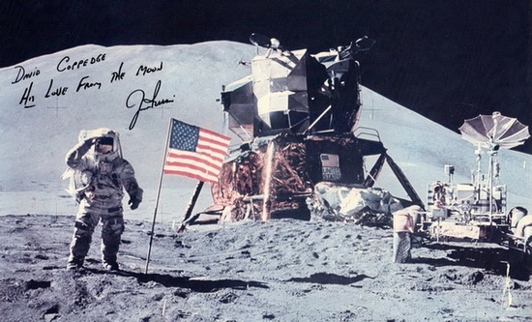
Apollo 15 – Jim Irwin

Slide 3
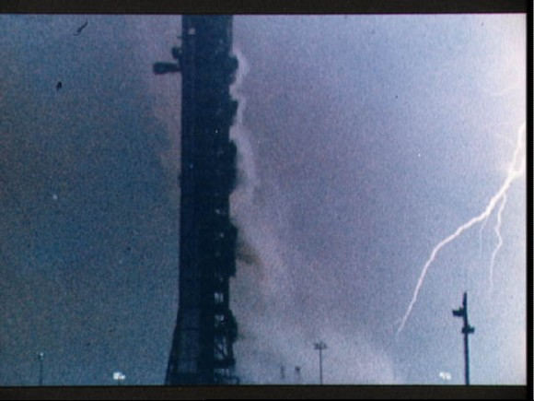
Apollo 12 & the lightning

Slide 4
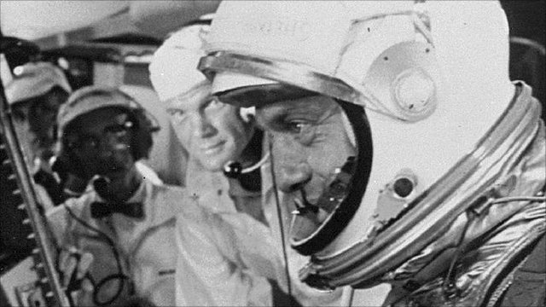
Alan Shepard: 1st American in space

Slide 5
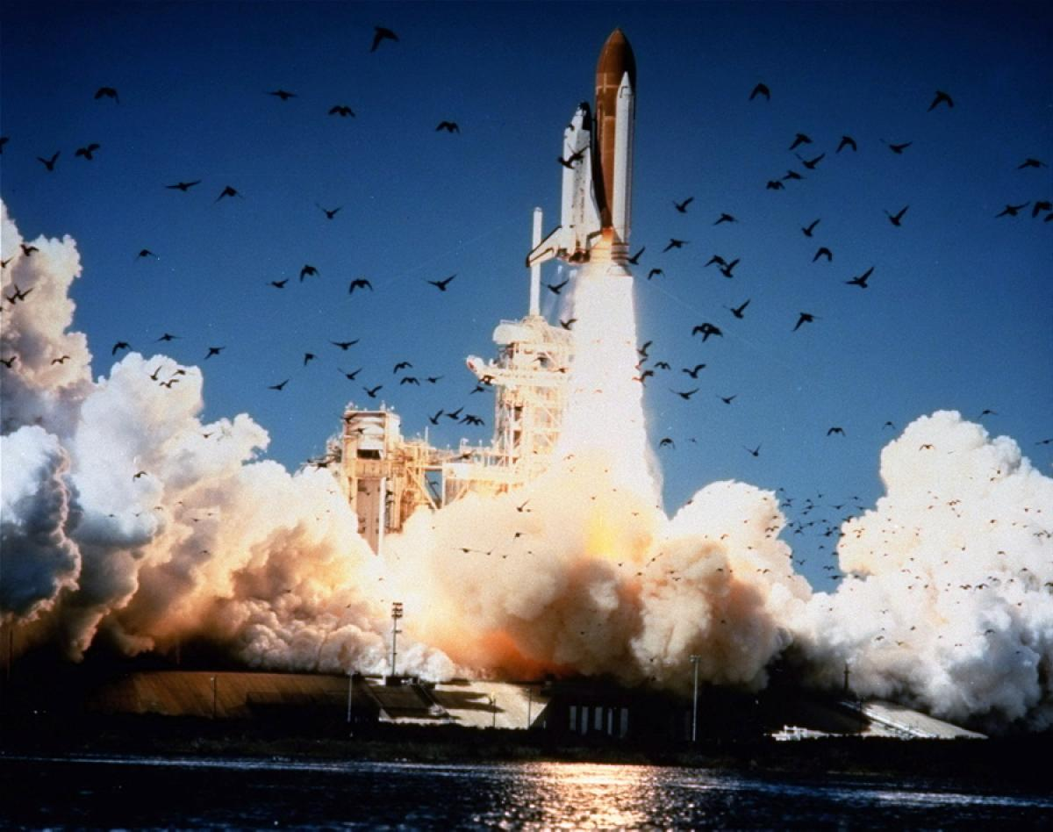
The Challenger explosion

Slide 6
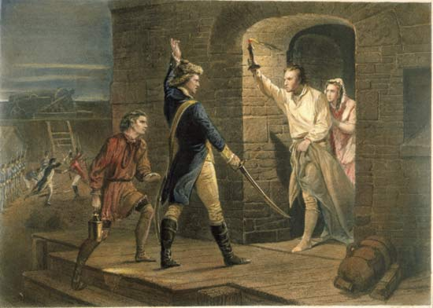
Capturing Fort Ticonderoga

Slide 7
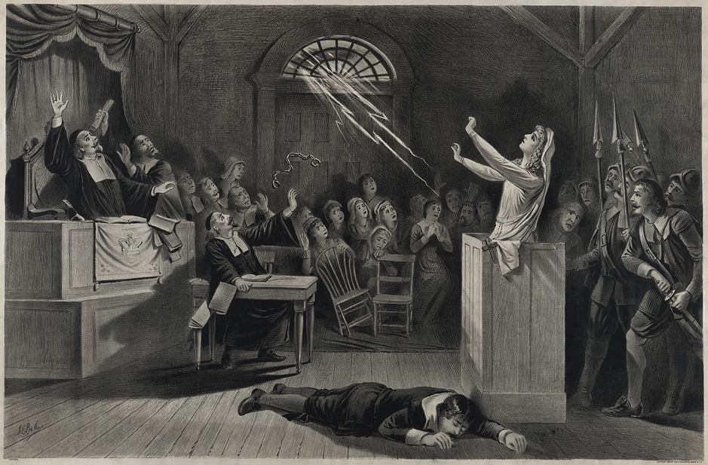
The Salem witch trials

Slide 8
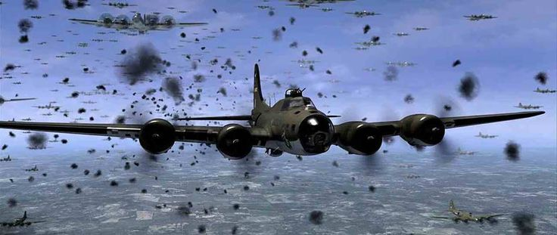
World War II air warfare

Slide 9
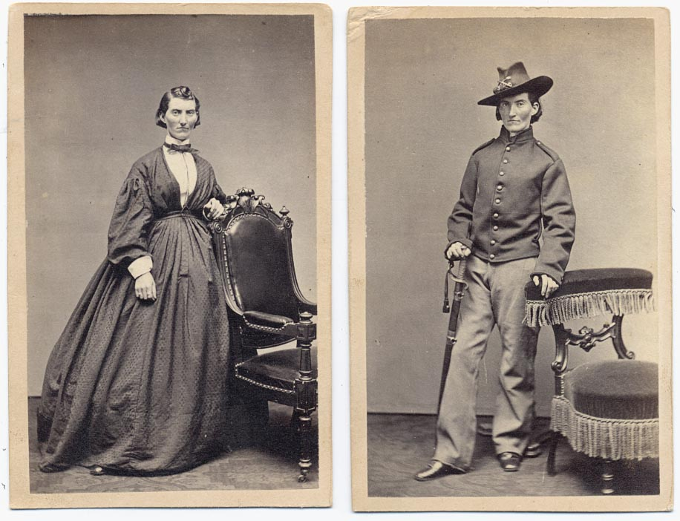
Women who fought in the Civil War

Slide 10
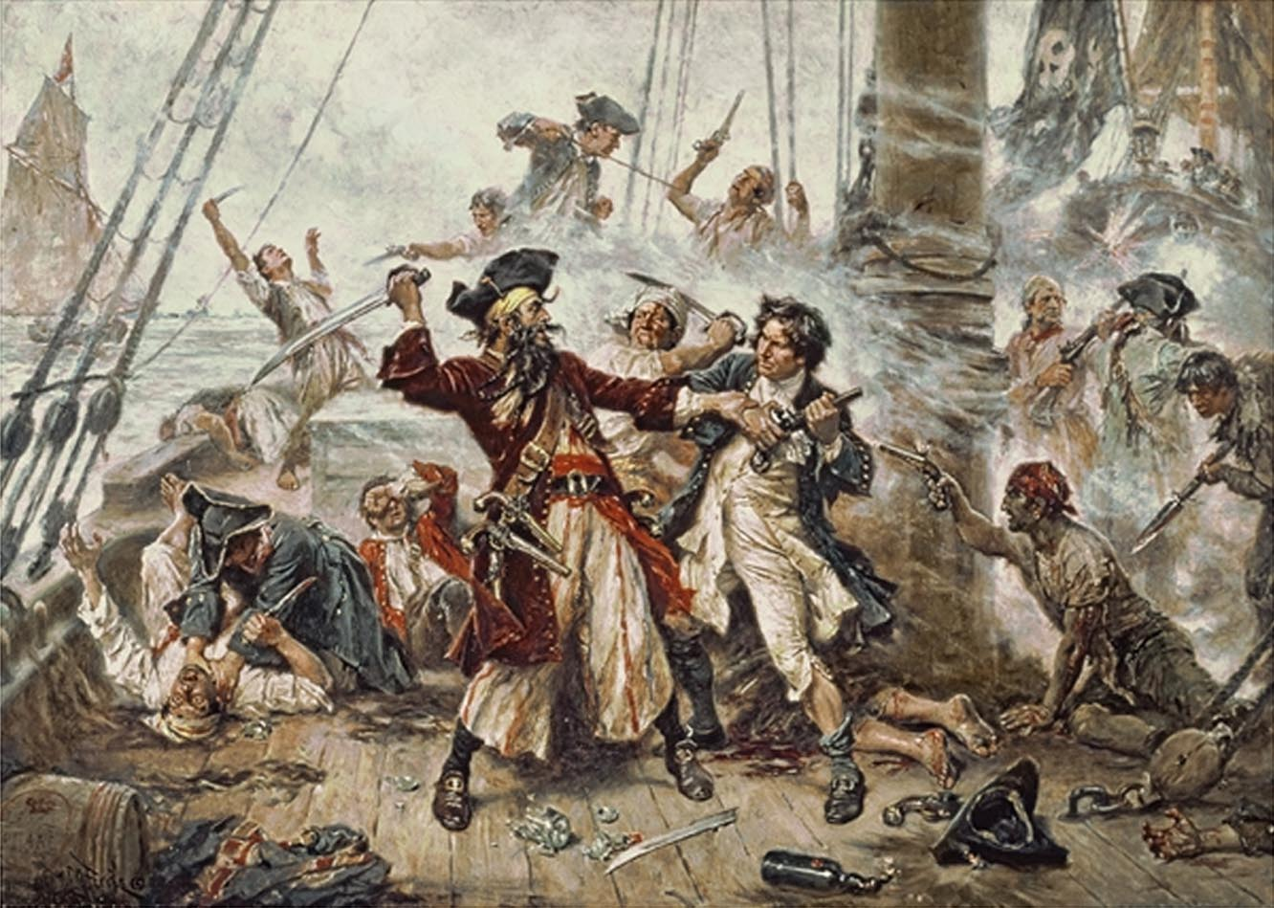
Pirates

Slide 11
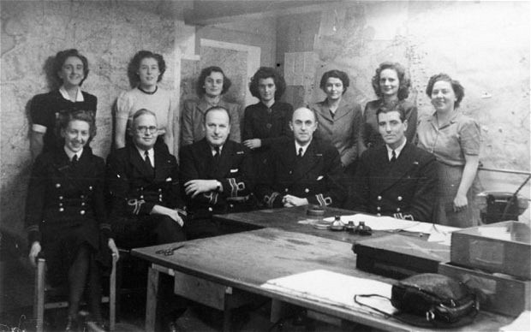
Operation Mincemeat

Slide 12
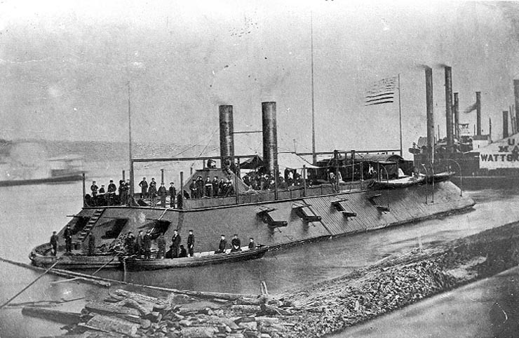
The ironclads

Slide 13
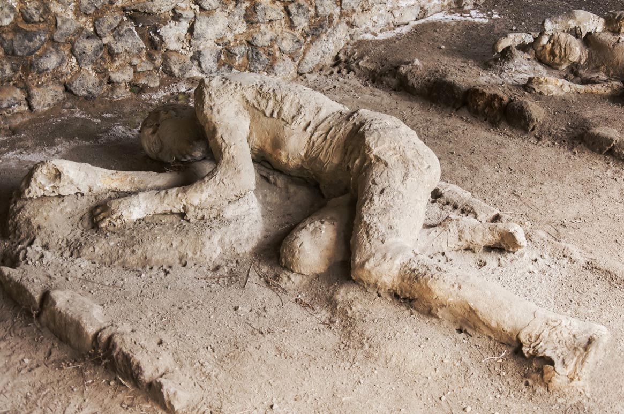
Pompeii & Herculaneum

Slide 14
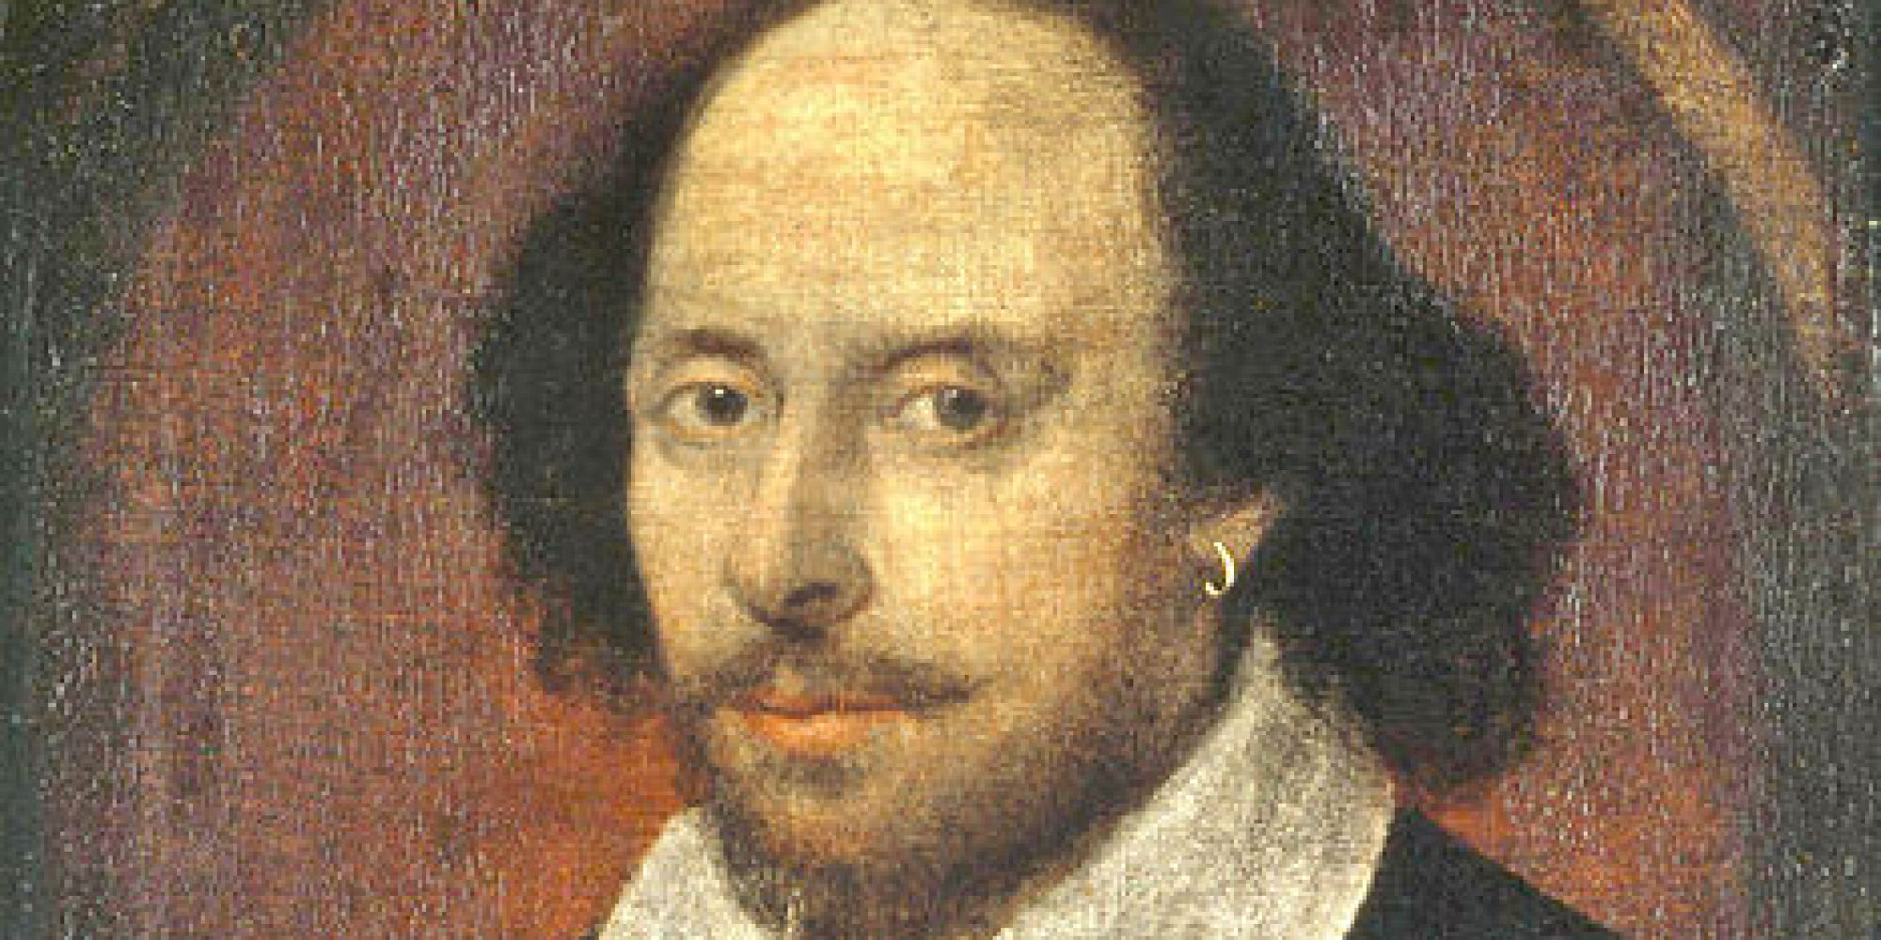
Shakespeare (did he write?)

Slide 15
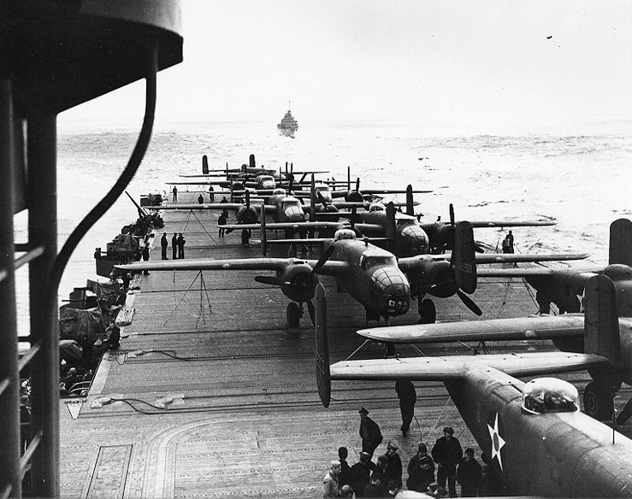
The Doolittle Raid

Slide 16
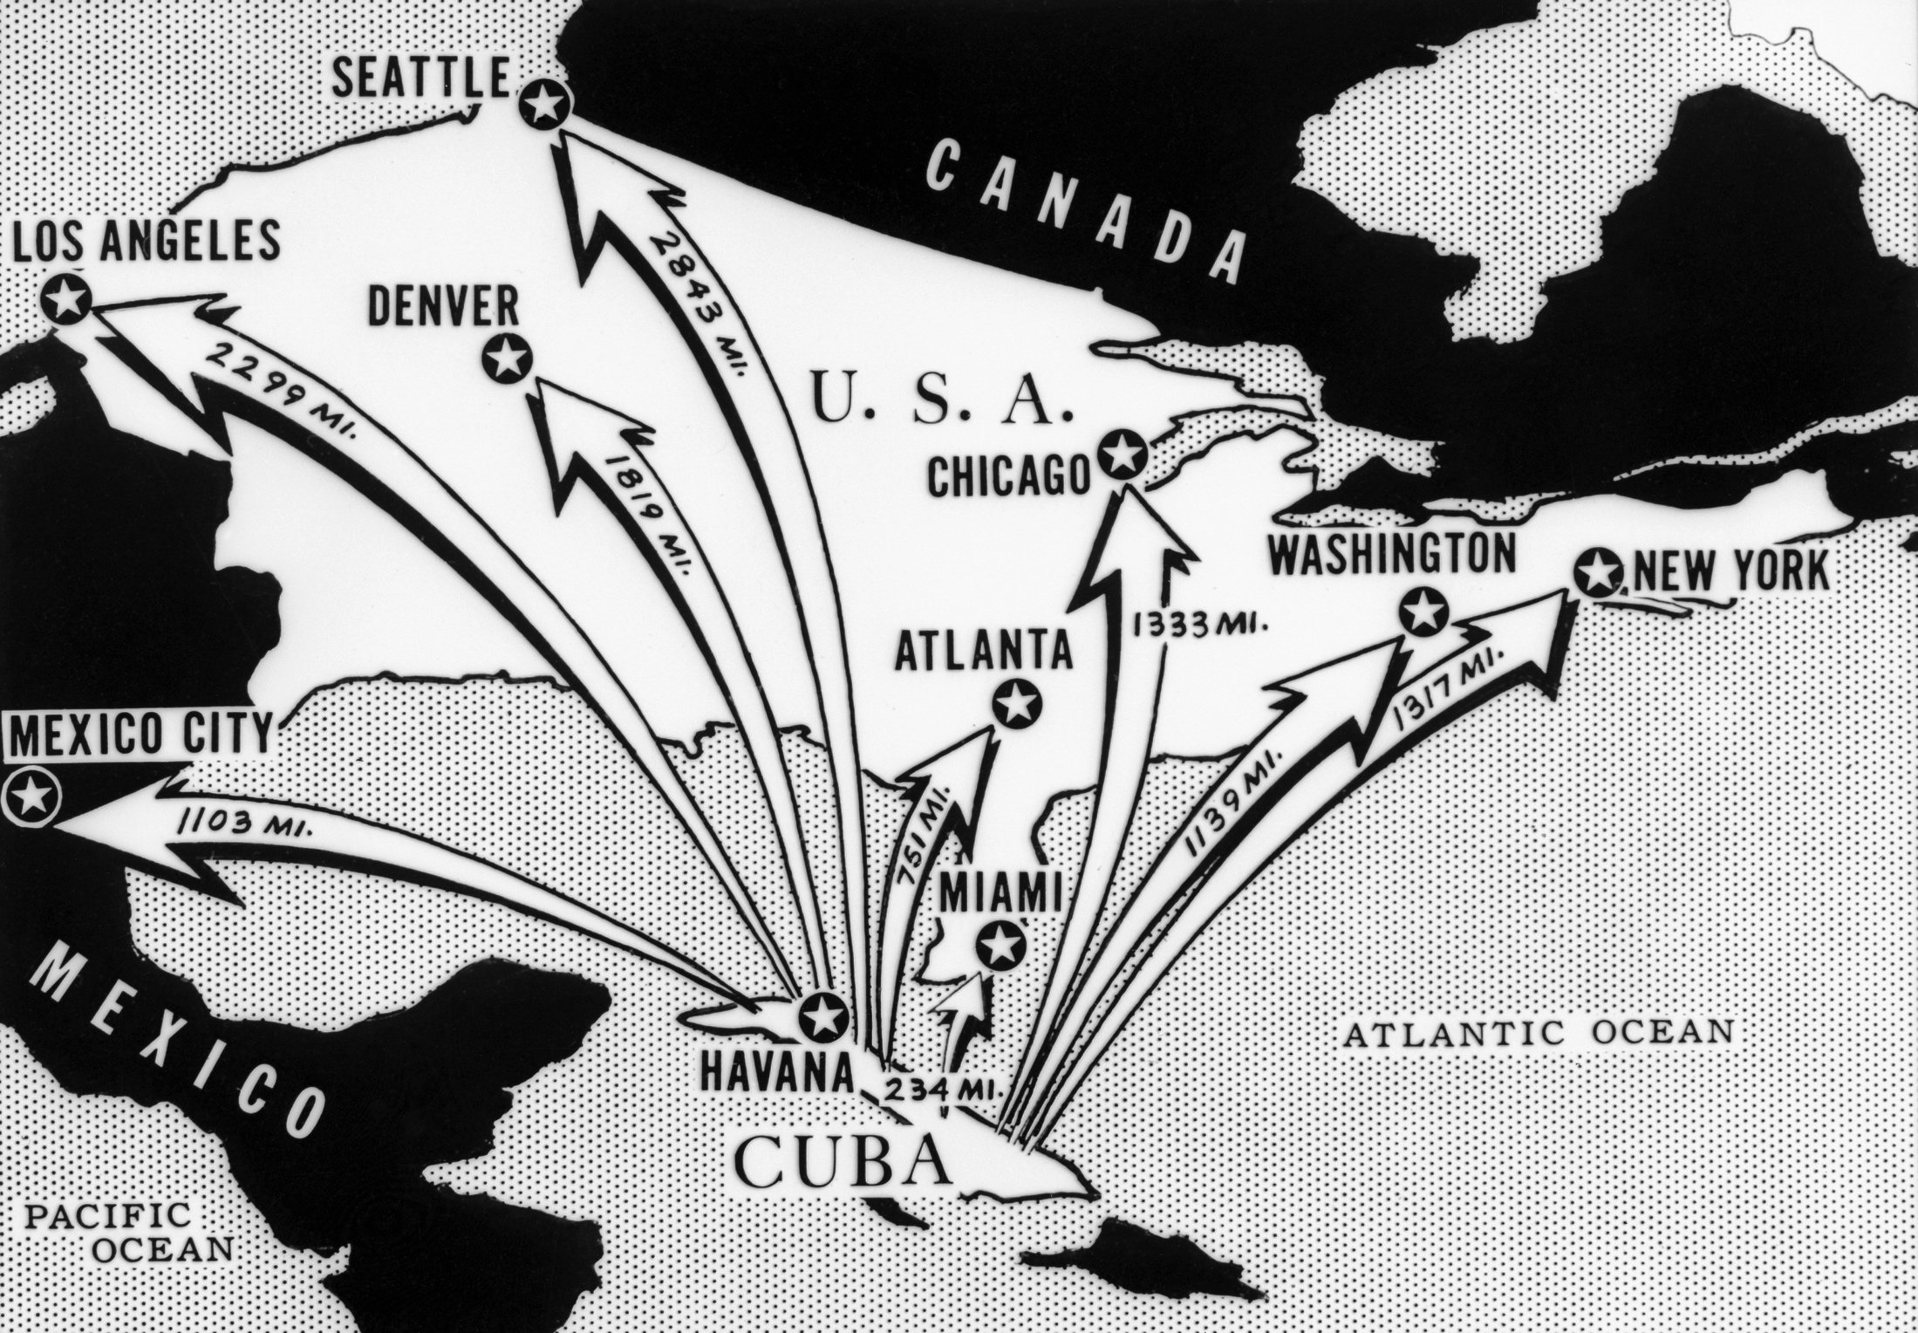
The Cuban Missile Crisis

Slide 17
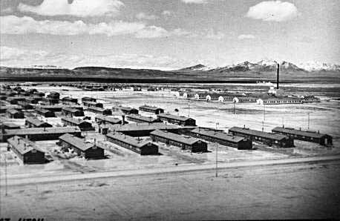
Japanese interment - Topaz

Slide 18
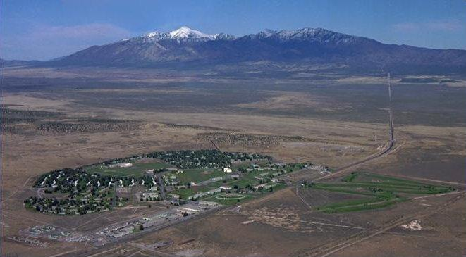
Dugway, Utah

Slide 19
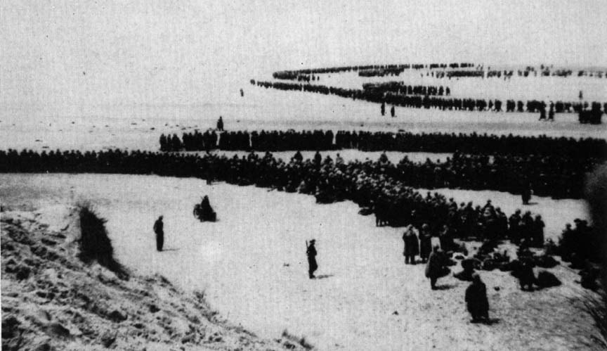
The evacuation of Dunkirk

Slide 20
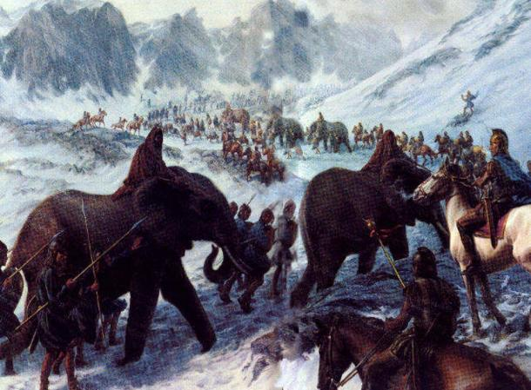
Hannibal (not the cannibal)

Slide 21
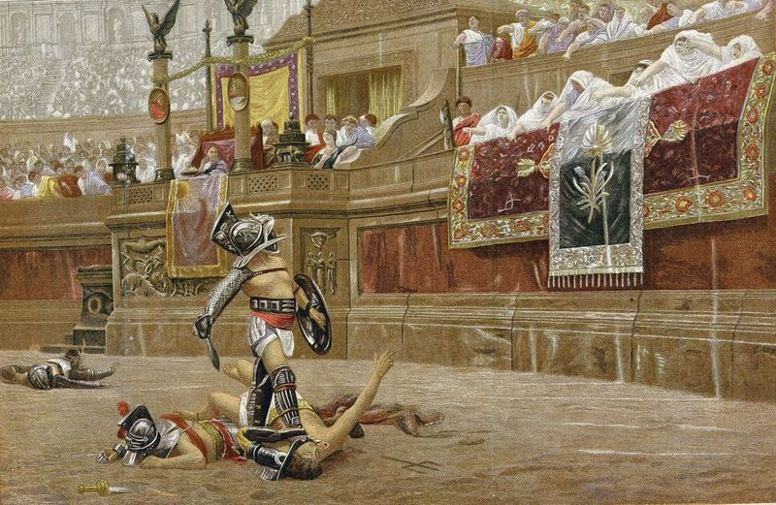
Gladiators

Slide 22
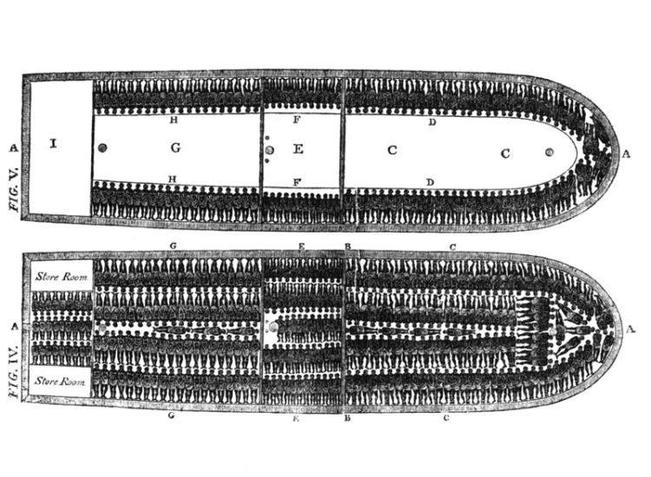
The slave trade

Slide 23
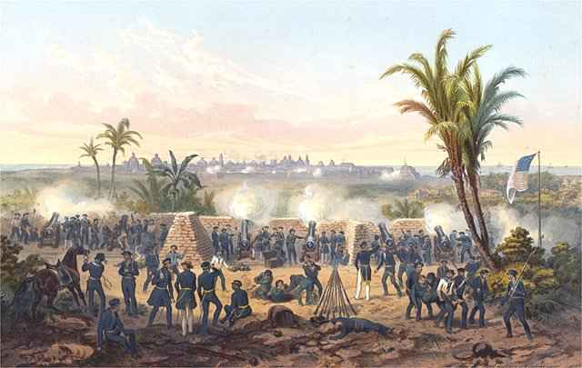
The Mexican-American War

Slide 24
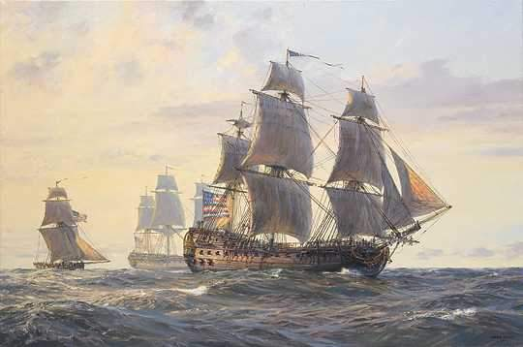
John Paul Jones

Slide 25
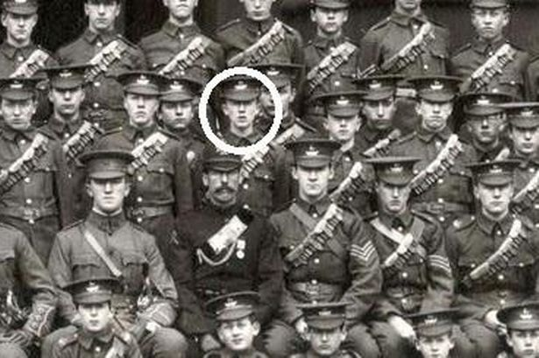
World War I and Lord of the Rings

Slide 26
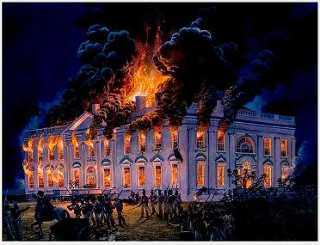
War of 1812: Burning the White House

Slide 27
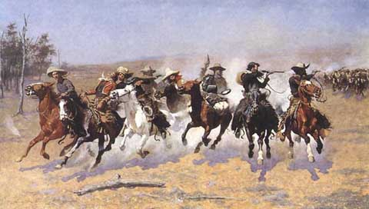
Cowboys in the West

Slide 28
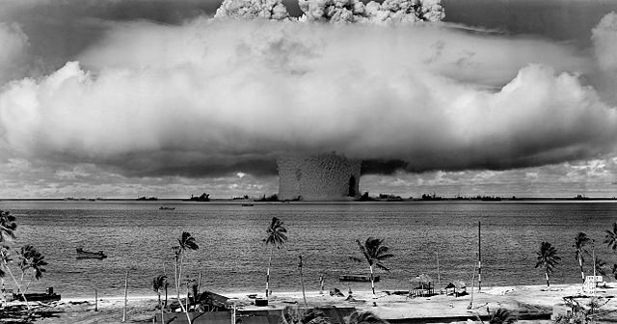
The Manhattan Project

Slide 29
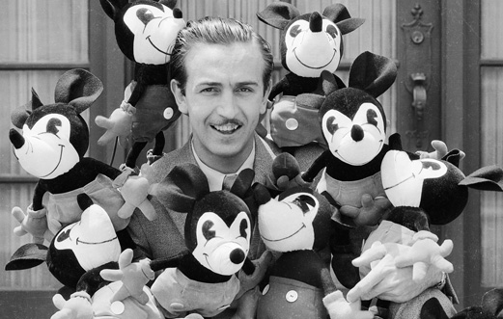
Walt Disney

Slide 30
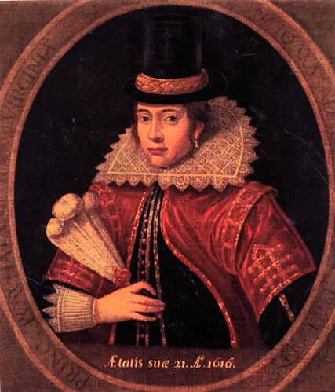
Pocahontas

Slide 31
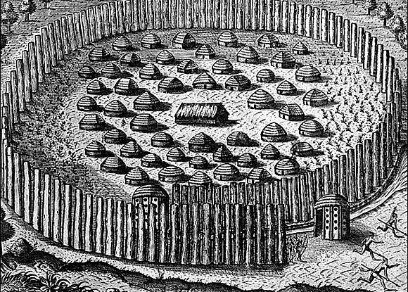
Roanoke – the lost colony

Slide 32
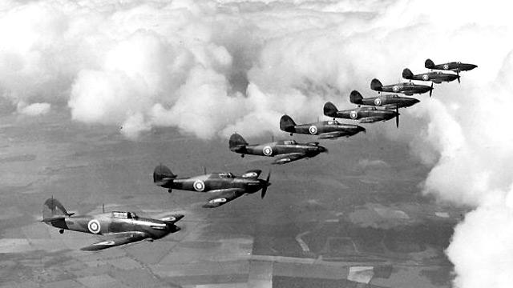
The Battle of Britain

Slide 33
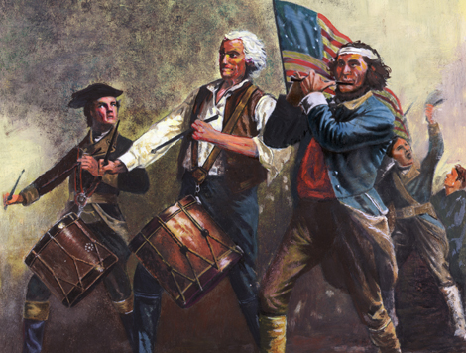
Yankee Doodle

Slide 34
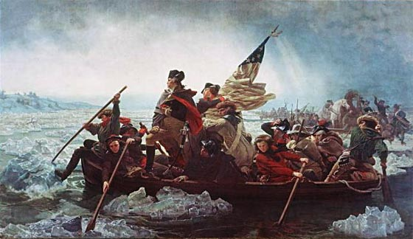
The Battle of Trenton

Slide 35
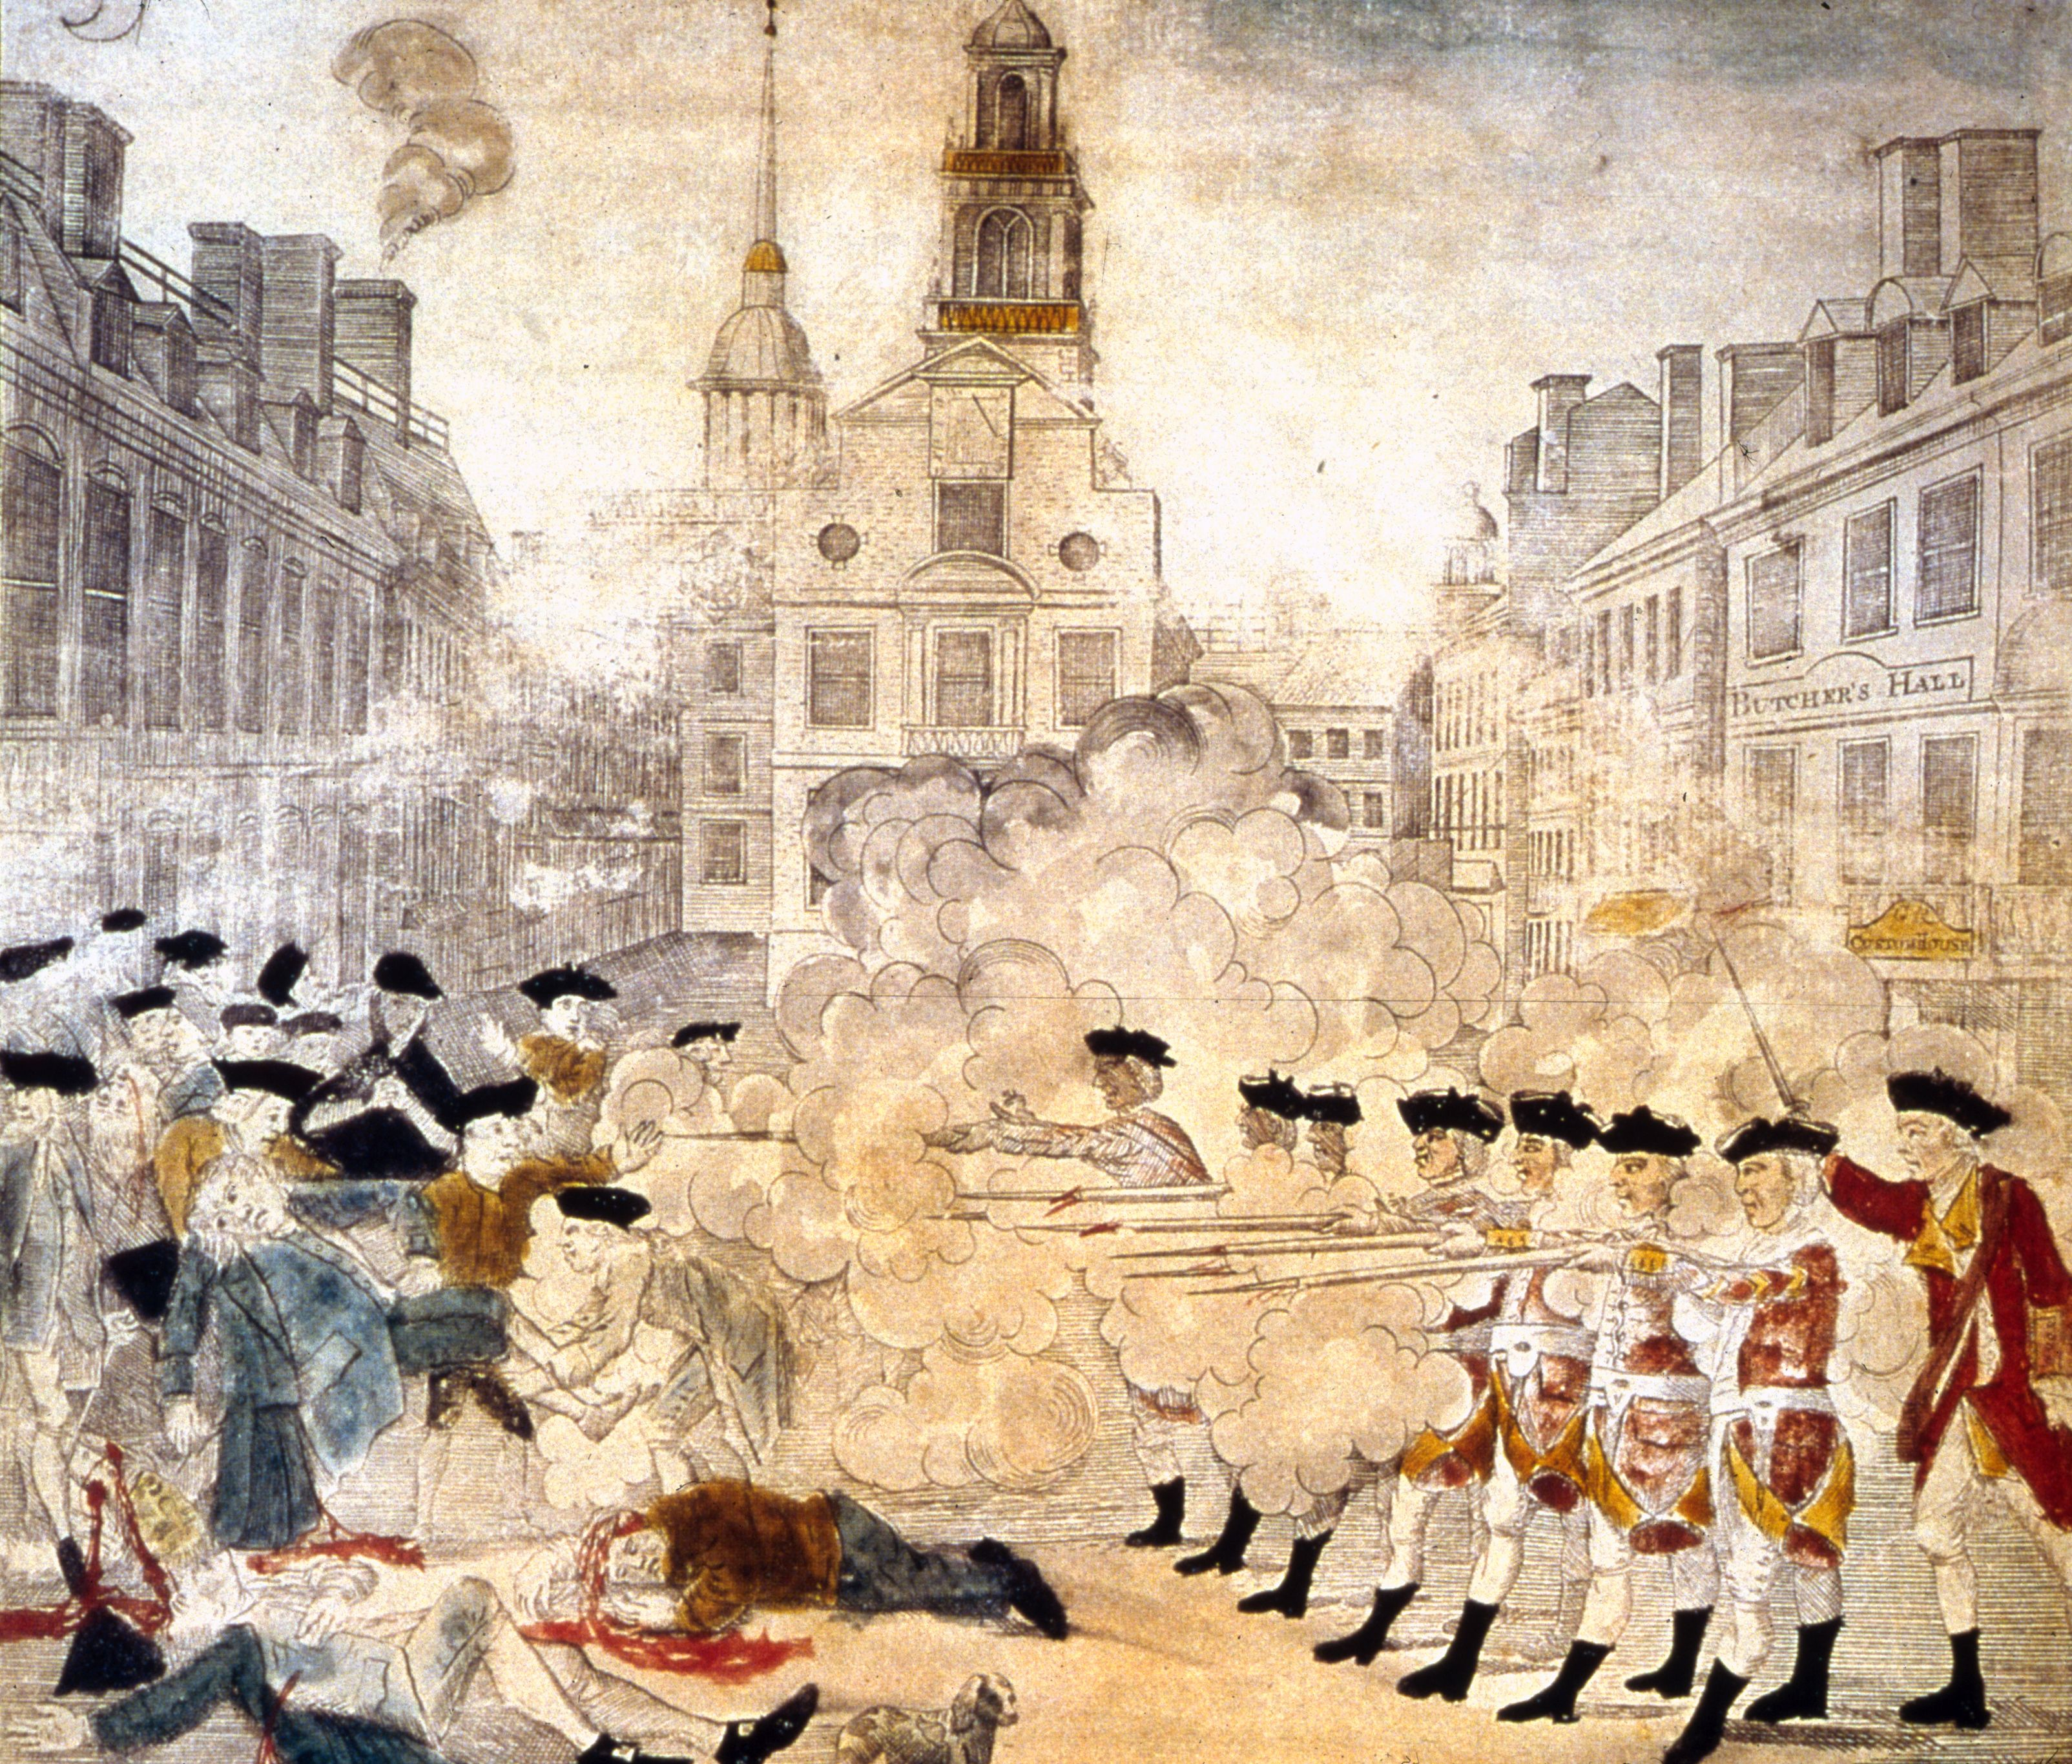
The Boston Massacre

Slide 36
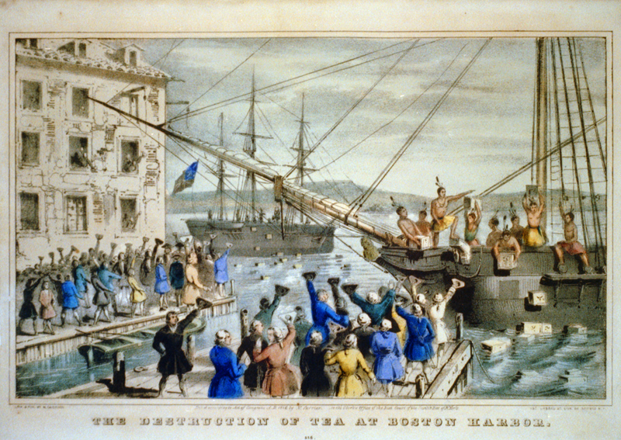
The Boston Tea Party

Slide 37
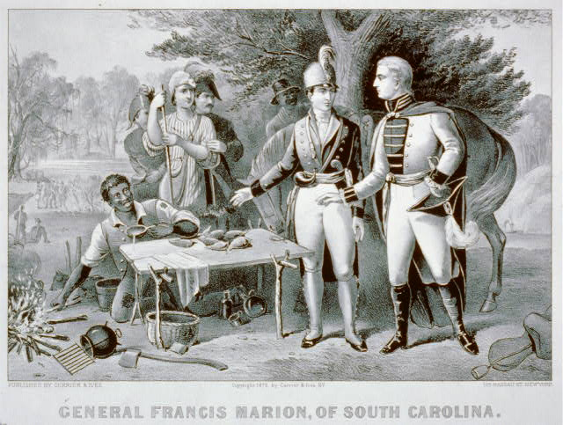
The Swamp Fox (Francis Marion)

Slide 38
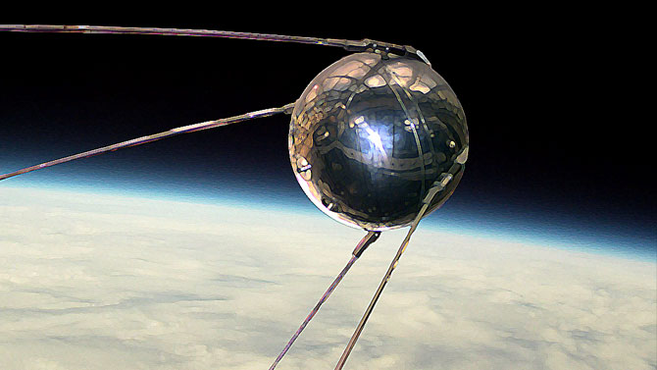
Sputnik

Slide 39
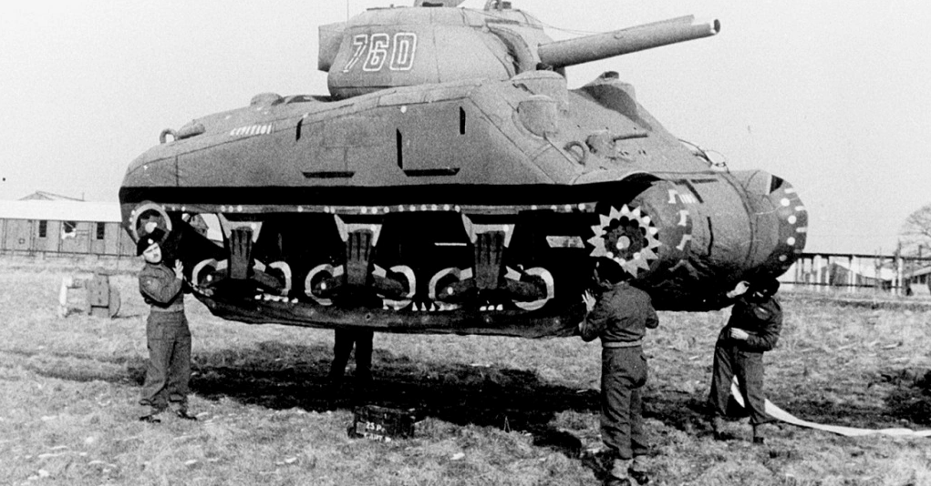
Inflatable tanks & the “Ghost Army”

Slide 40
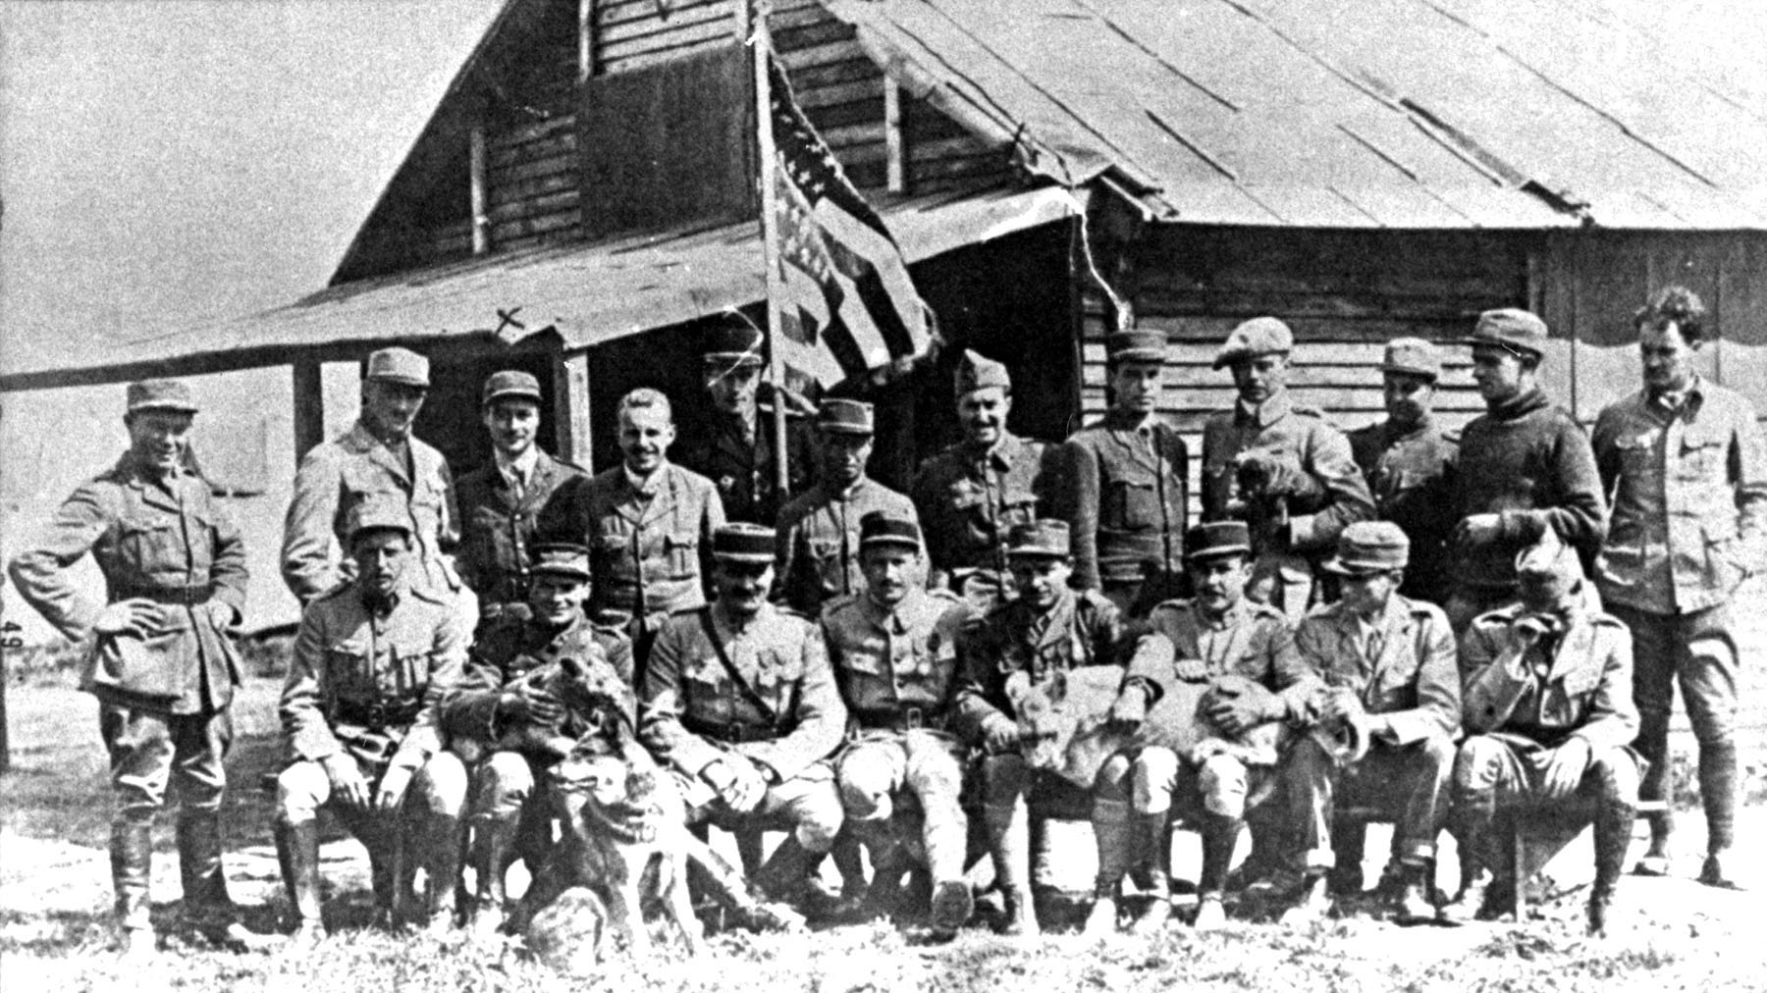
The Lafayette Escadrille

Slide 41
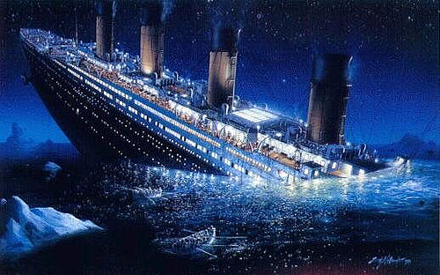
Titanic

Slide 42
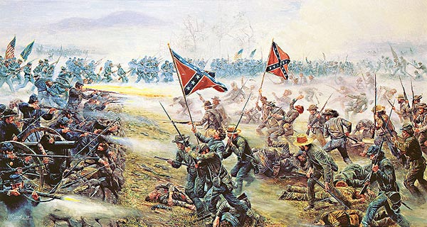
Gettysburg

Slide 43
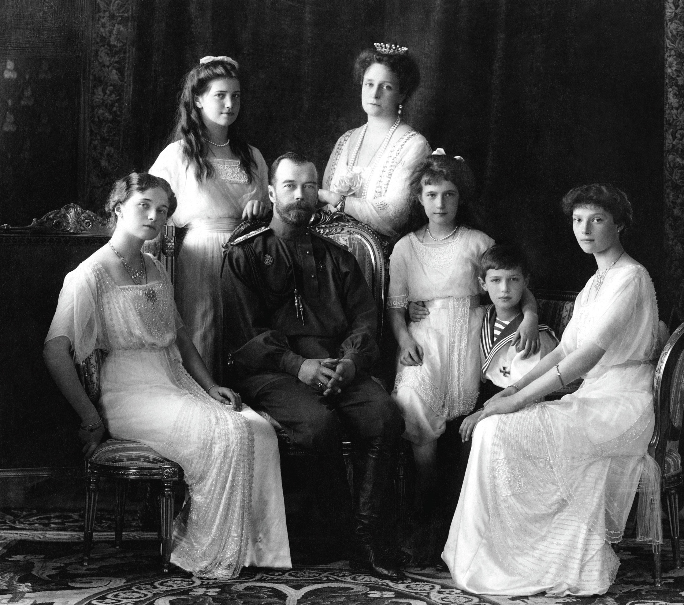
Anastasia & the Bolshevik Revolution

Slide 44
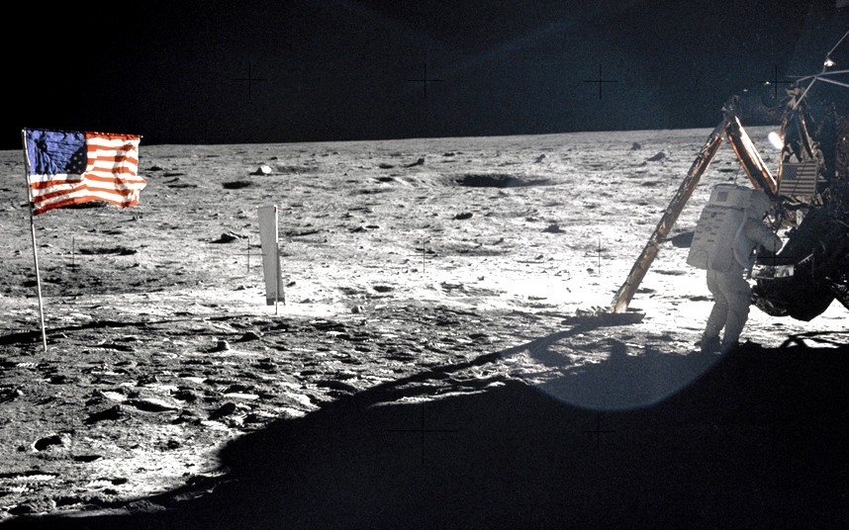
Apollo 11

Slide 45
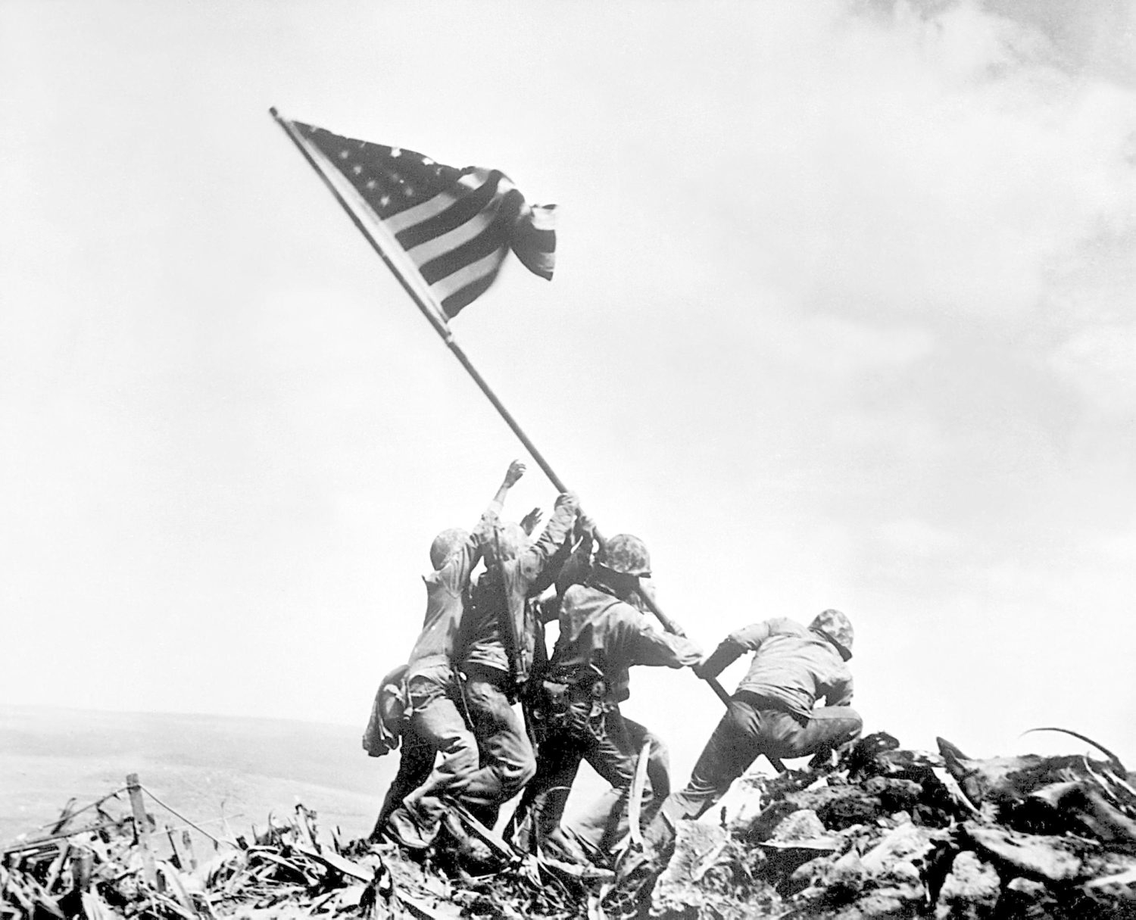
Iwo Jima, WWII

