Slide 1
Imagery
Imagery:
Visually descriptive or figurative language, especially in a literary work
Language that activates the 5 senses

Slide 2
Figurative language
Figurative language:
Using language in a way that is different from its normal, everyday meaning
Metaphors, Similes, Analogies, Symbolism, Hyperbole, Personification, Idioms, Onomatopoeia, Alliteration, etc.

Slide 3
Figurative language
Simile –
A comparison between two items that uses the words like or as
The sea roared like a tiger

Slide 4
Figurative language
Metaphor –
A comparison between two or more items
The sky was a distant black curtain of falling rain

Slide 5
Figurative language
Onomatopoeia – Words that imitate natural sounds
Baa
Bark
Buzz
Clap
Cough
Achoo
Click
Gargle
Hiss
Murmur
Rattle
Sizzle
Zip
Moo
Swish

Slide 6
Figurative language
Hyperbole –
Exaggerated statements or claims
Ice cream heaped as high as the Himalayas

Slide 7
Figurative language
Symbol –
Something used to represent qualities or ideas

Slide 8
Figurative language
Irony – An expression of one’s meaning by using language that normally signifies the opposite, typically for humorous or emphatic effect

Slide 9
Figurative language
Verbal irony – The use of words to mean something different than what they appear to mean
“Oh boy, lucky me”
“I love tests”
“Nice cat”

Slide 10
Figurative language
Situational irony – The difference between what is expected to happen and what actually happens
Notes:
Finding Nemo
Finding Nemo
Emperor’s New Groove

Slide 11
Figurative language
Dramatic irony – When the audience is aware of what is happening and the character is not
Notes:
Oedipus
Simba & Scar
Chillingworth and Dimmesdale
Beauty and the Beast on ice

Slide 12
Figurative language
Pun – A humorous way of using a word or phrase so that more than one meaning is suggested
Time flies like an arrow. Fruit flies like a banana.
Notes:
Pun video

Slide 13
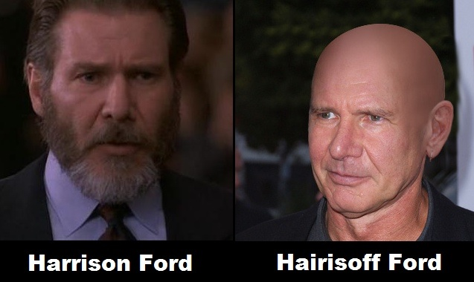

Slide 14
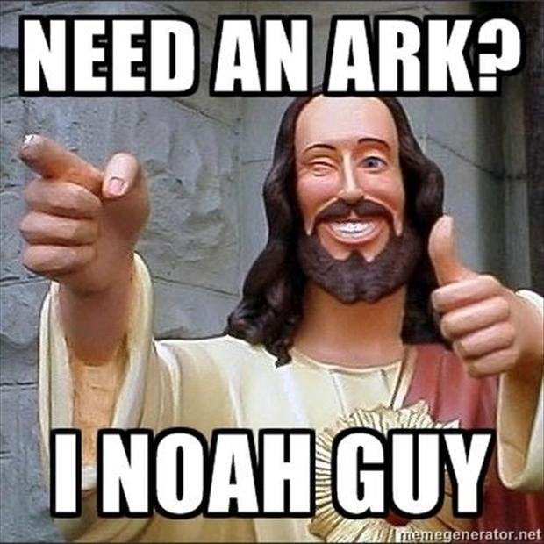

Slide 15
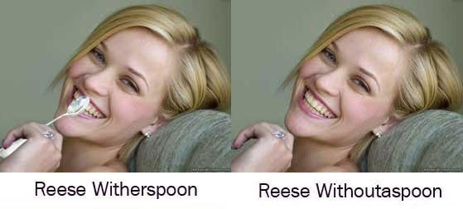

Slide 16
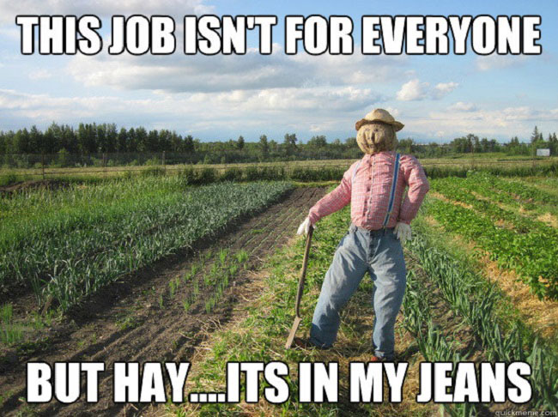

Slide 17
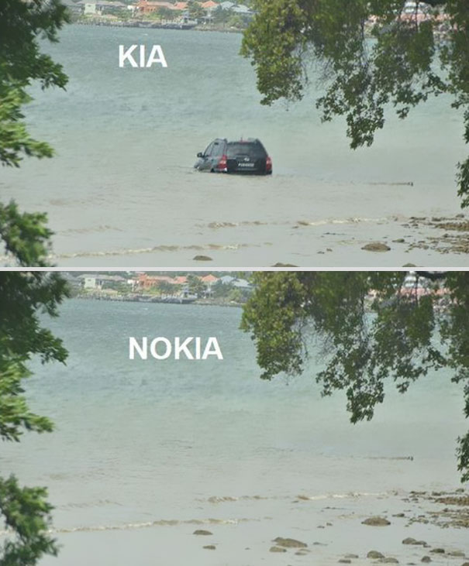

Slide 18
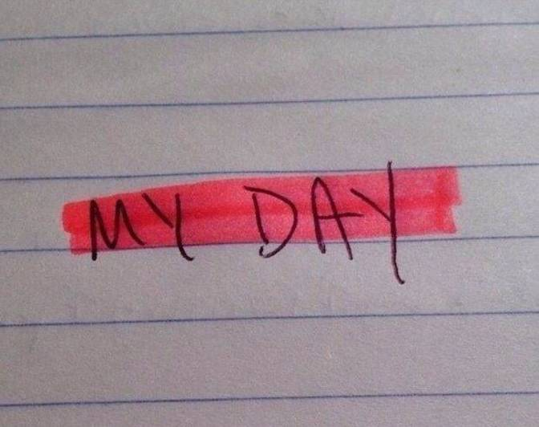

Slide 19
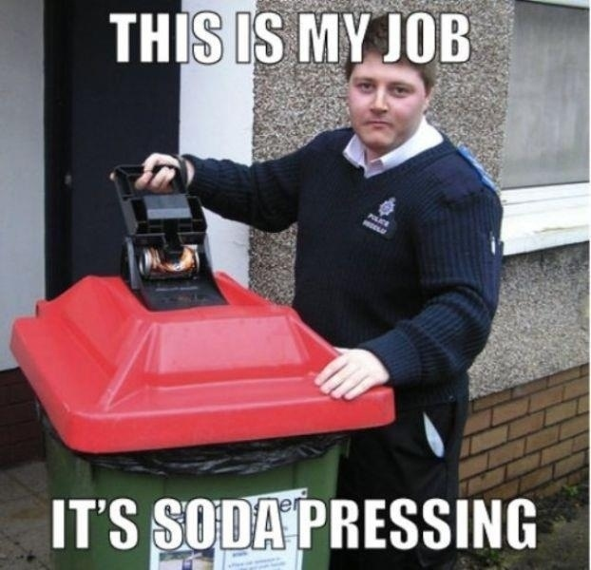

Slide 20
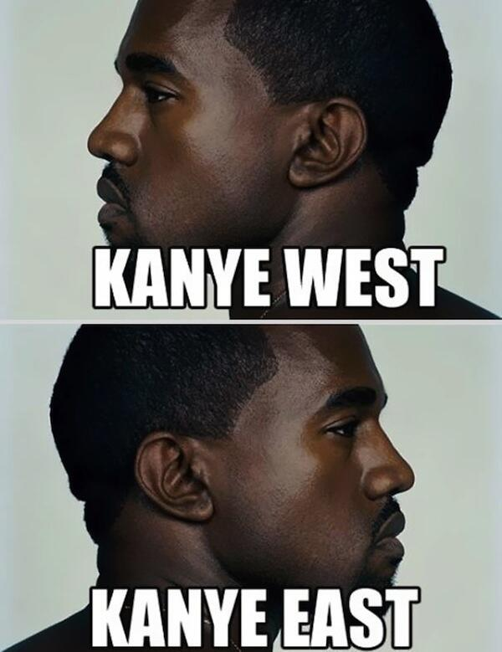

Slide 21
Figurative language
Oxymoron – A combination of words that have opposite or very different meanings
Open secret
Liquid Gas
Pretty ugly
Minor crisis
Old news
Crash landing
Jumbo shrimp
Bittersweet
Civil war
Seriously funny

Slide 22
Figurative language
Alliteration – The use of words that begin with the same sound near one another
Bury the body in the backyard
Best bring a bucket before Betty Bumbrake blows her bloomin’ breakfast!

