Slide 1
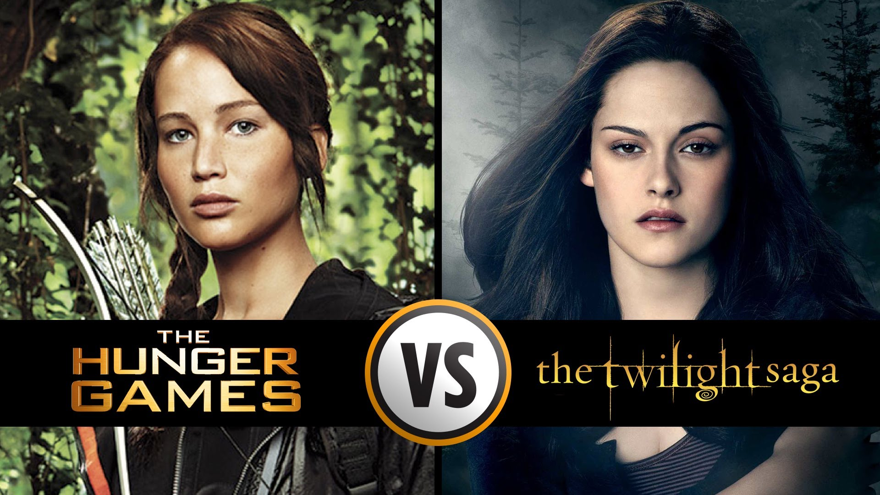
Elements of literature
AKA: The reason The Hunger Games
is better than Twilight

Slide 2
Story structure
All good stories follow a basic structure with at least one conflict, climax, and conclusion
Climax
Rising action
Falling action
Conflict
Conclusion/denouement
Exposition

Slide 3
Story structure
Exposition: The beginning of the story, including the setting and the characters
Conflict: The problem that must be solved
Rising action: Events that build suspense and increase interest in the story

Slide 4
Story structure
Climax: The point of greatest suspense and intensity
Falling action: Events that wrap up a story
Resolution/denouement: How the story ends and the problem is solved

Slide 5
Mood & Tone
Mood: The overall feeling the work creates in you, the reader; the atmosphere of the piece
What did the 5 assigned stories make you feel?
Tone: The author’s overall attitude toward a subject; shown through the author’s use of language, word choice, phrasing, and sentence structure
What was the tone of the 5 stories?

Slide 6
Theme
An abstract idea that emerges from a literary work’s treatment of its subject matter
What was the theme of “The Cold Equations”?
What was the theme of “Chickamauga”?
What was the theme of “All Summer in a Day”?
What was the theme of “Harrison Bergeron”?
What was the theme of “The Tell-Tale Heart”?

Slide 7
The bigger picture
Sometimes stories are a commentary on society or events writers imagine could one day happen, or events writers are seeing around them
What could “Harrison Bergeron” be commenting on?
What could “Chickamauga” be commenting on?

Slide 8
Archetype
A recurrent symbol or motif in literature, art, or mythology
The root could be the “collective unconscious” of mankind, or the experiences shared by race or culture
Love
Religion
Death
Birth
Life
Struggle
Survival

Slide 9
Characterization
Protagonist: The main work around whom much of the story revolves
Antagonist: Someone/something that contends against the main character
Dynamic characters: Experience change or growth in a story
Static characters: Experience little to no change or growth in a story

Slide 10
Characterization
Foil: A character who contrasts with another character in order to highlight particular qualities of the other character
Are there characters who act as foils in the five assigned stories you read?

Slide 11
Narration
Narrator: The person telling the story; may or may not be a character
1st person narrator: Uses “I” or “we,” tells the story from his/her perspective
2nd person narrator: Uses “you” to tell you (the reader) what you think, feel, and do
3rd person narrator: Does not use “I,” “we,” or “you.” An omniscient outsider

Slide 12
Narration
Unreliable narrator: A narrator who cannot be trusted for a variety of reasons
Sometimes you can recognize unreliable narrators
Sometimes you can’t…

Slide 13
Symbolism
When an object is meant to be representative of something or an idea greater than the object itself
Did you see any symbolism in any of the stories you read?

Slide 14
Allusion
A figure of speech where an author refers to a story, event, person, or object in order to make a comparison in the readers’ minds

Slide 15
Foreshadowing
When the writer clues the reader in to something that will eventually occur in the story

Slide 16
Suspense
The tension that the author uses to create a feeling of discomfort about the unknown

Slide 17
Homework
List the 5 stories you chose to read
Identify each of these elements in the 5 stories you chose to read
One ID per element (don’t do each element 5 times!)
Tell me what story the element is found in, describe it, and describe why your element ID is correct
Practice finding the elements, because next time, you’ll be using them in your own stories…

